Slide 1
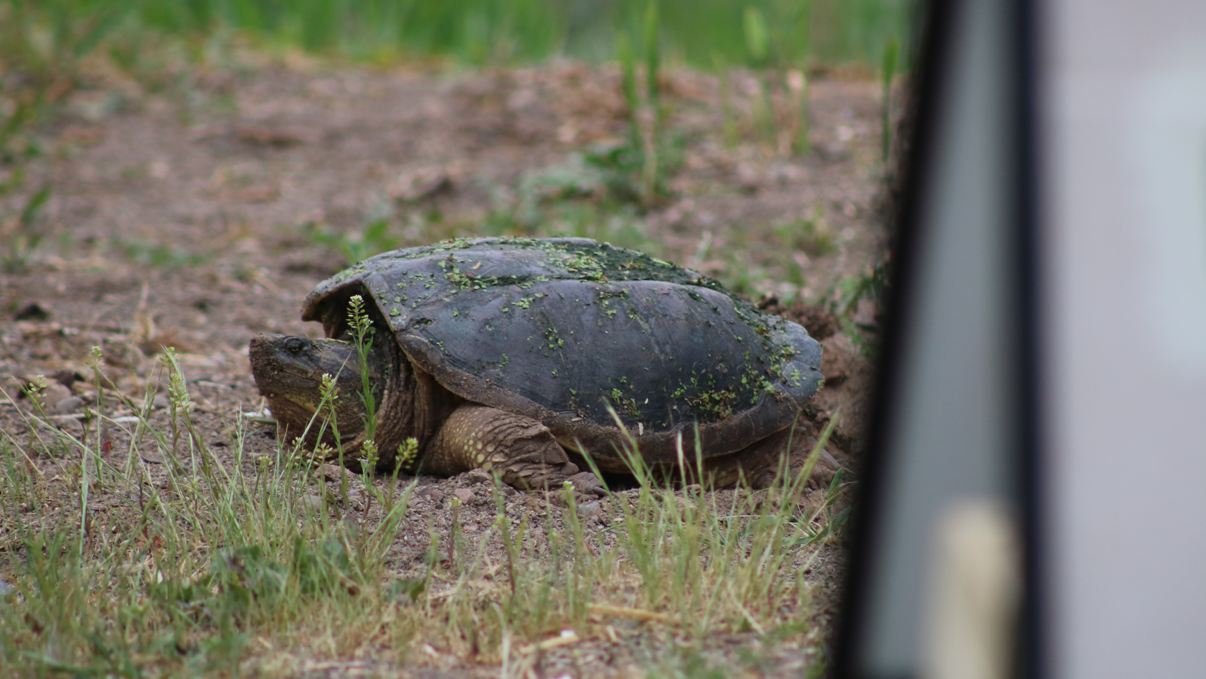

Snapping Turtle Monitoring Protocol

Slide 2
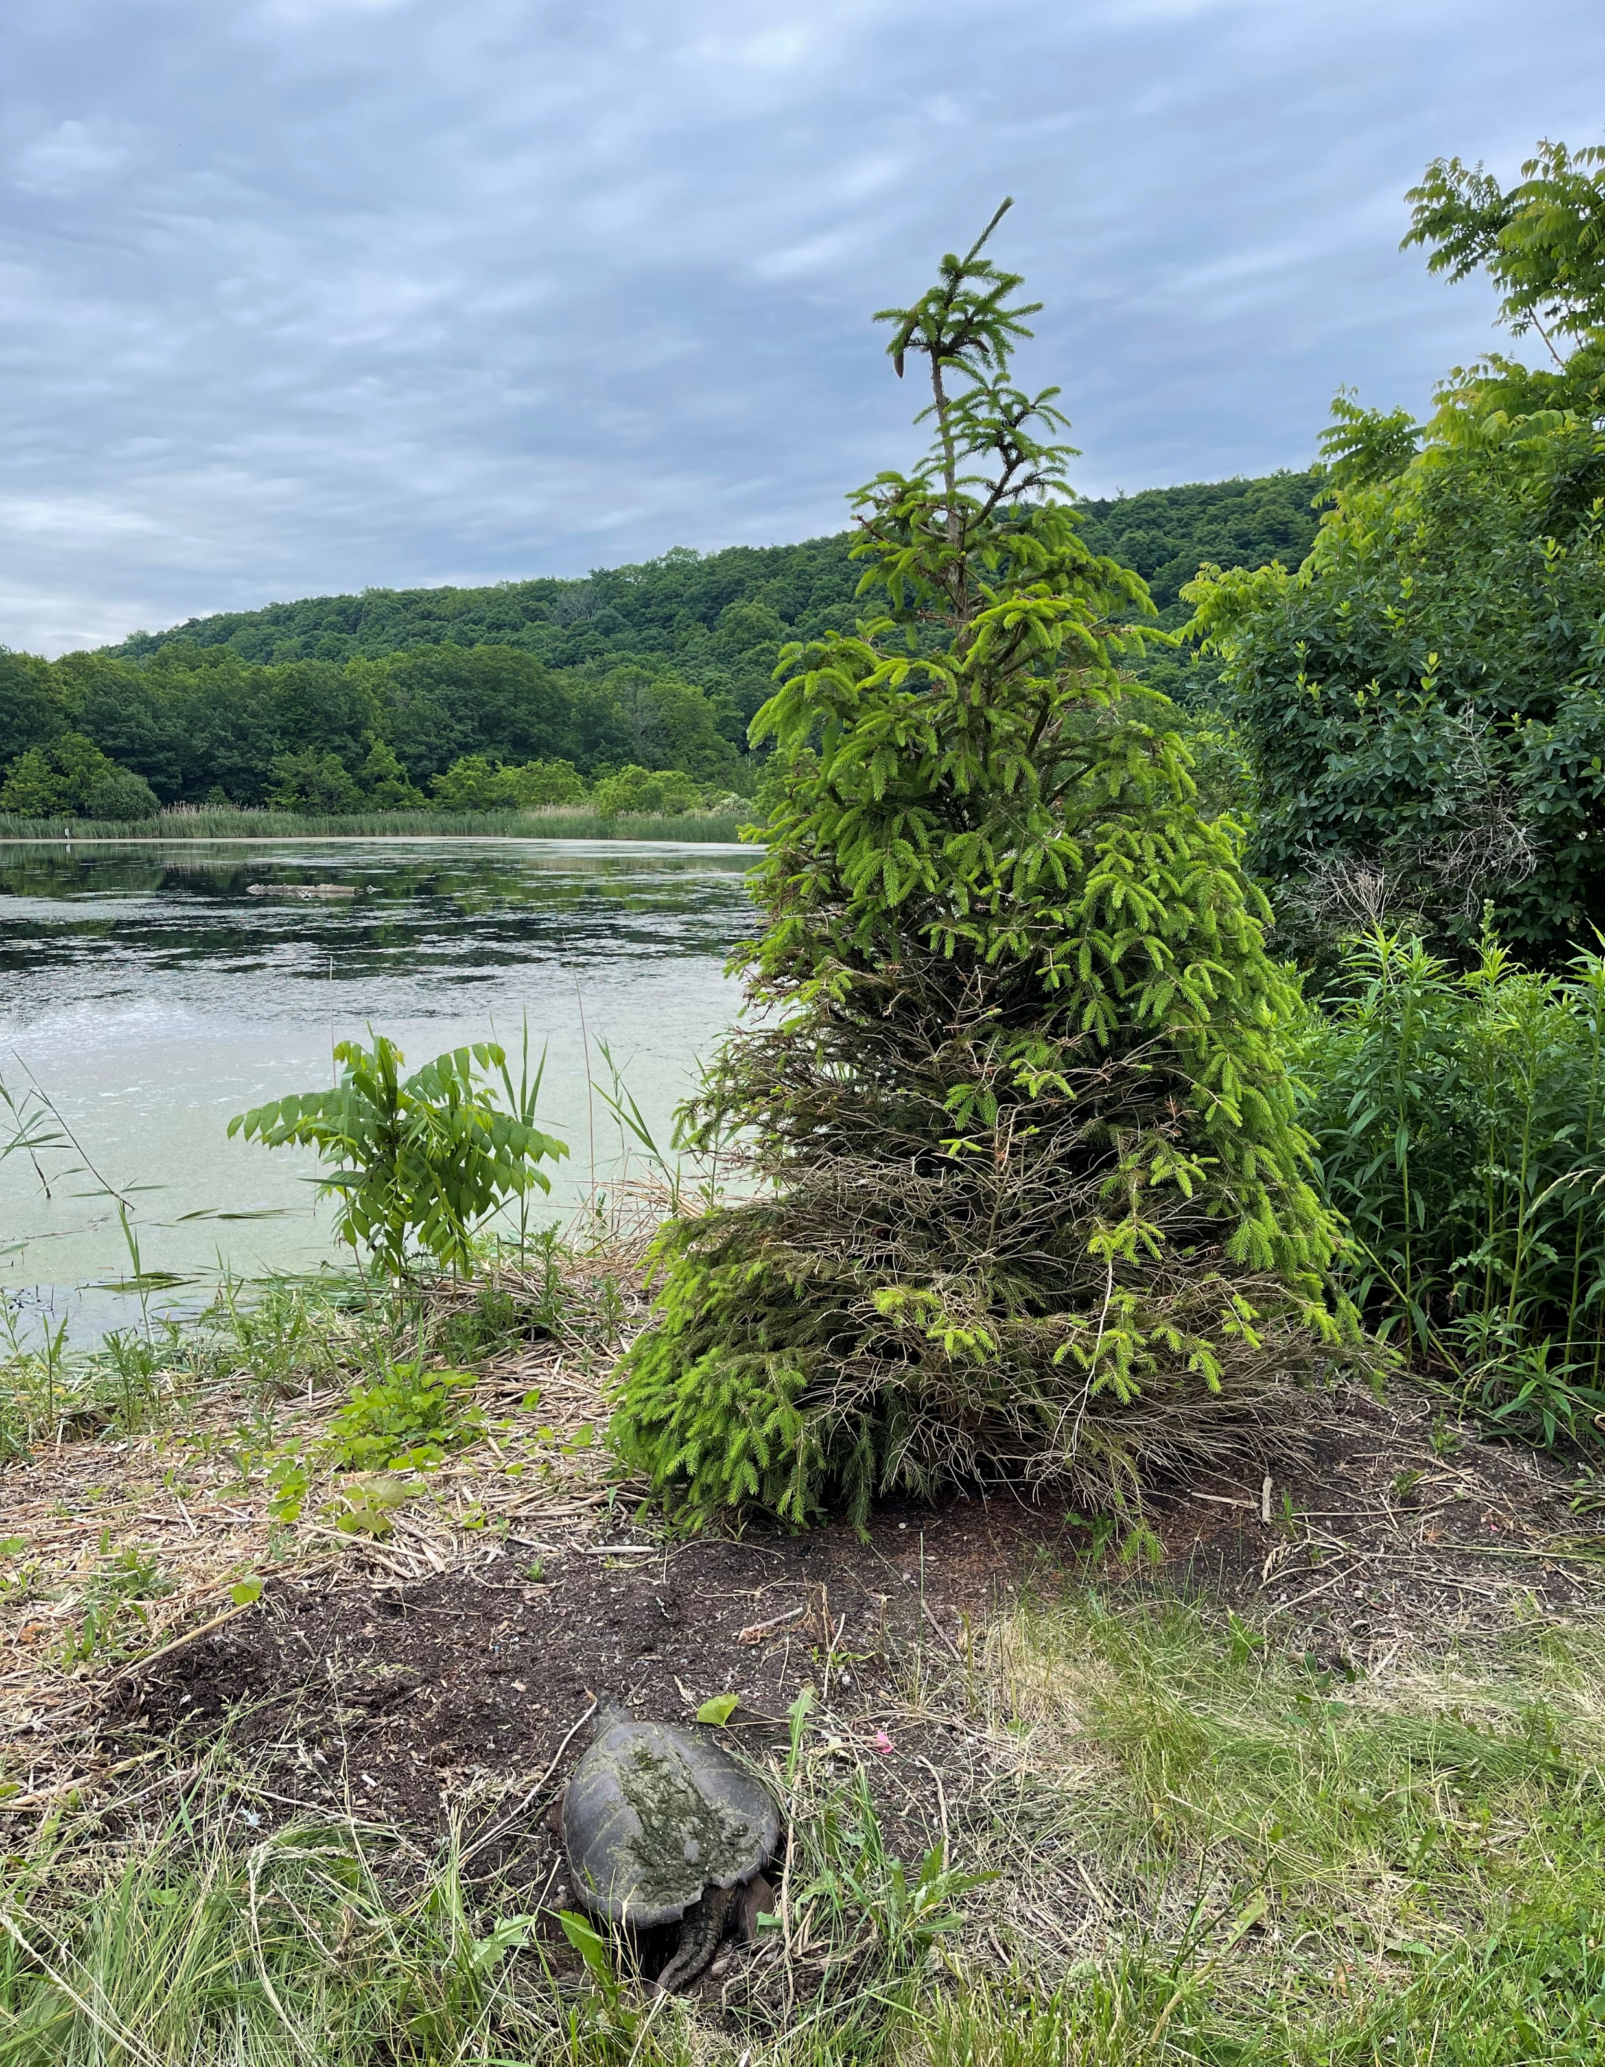
Overview
What is a Snapping Turtle?
Snapping Turtle Protocol
  Snapping Turtle monitoring 101
  Things to look for when monitoring
  Timeline of expecting laying period
  Proper installation of nest protectors

Slide 3
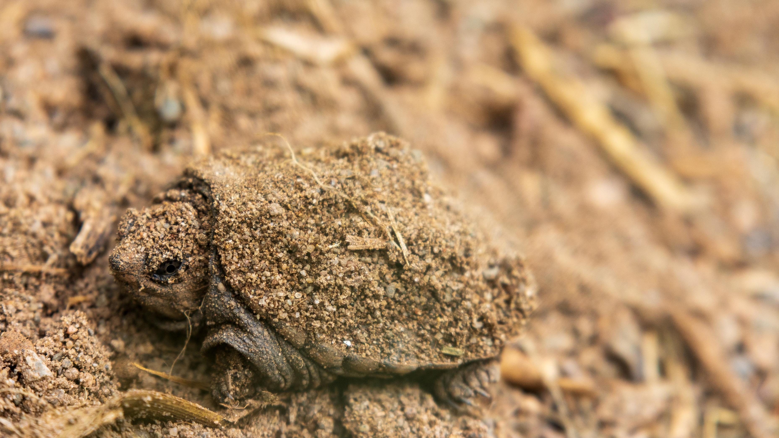
Snapping Turtles are a species of concern in Ontario (as are all turtles) due to loss of habitat and mortality suffered attempting to cross roadways to find suitable nesting sites
Snapping turtles can not retreat into their shell, like other turtles, so the ‘snapping’ is part of their defense mechanism
Despite the name, they will only snap if they feel threatened
Snapping Turtles are the largest freshwater turtles in Canada

Slide 4
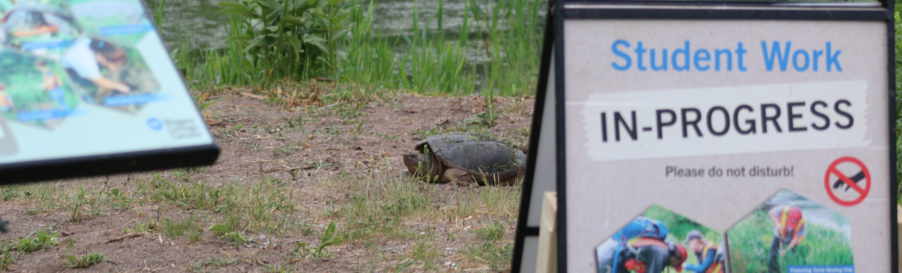
Snapping Turtle monitoring 101
Sign up for the times you are available on the Excel spreadsheet
Turtles are actively looking for nesting sites right after dawn and before dusk; which is why monitoring occurs in the early morning, and the late afternoon.

Slide 5
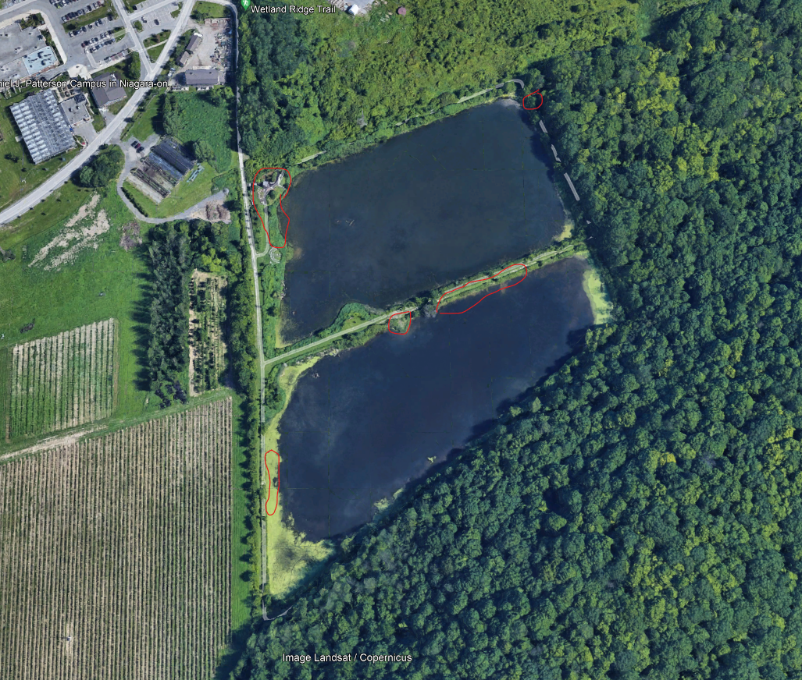
2024 Snapping Turtle nesting
site locations

Slide 6
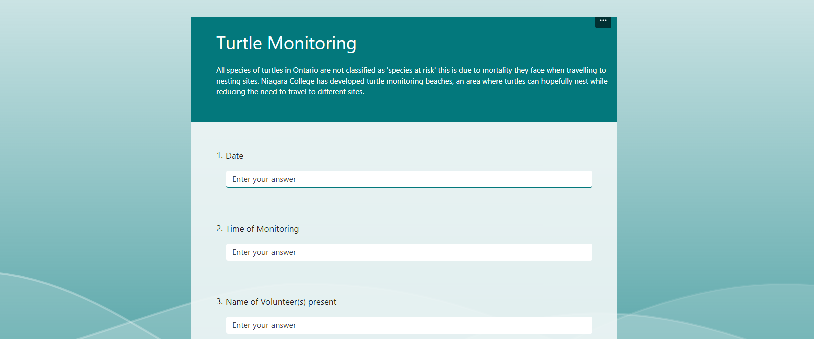
Open the Microsoft Forms

Slide 7
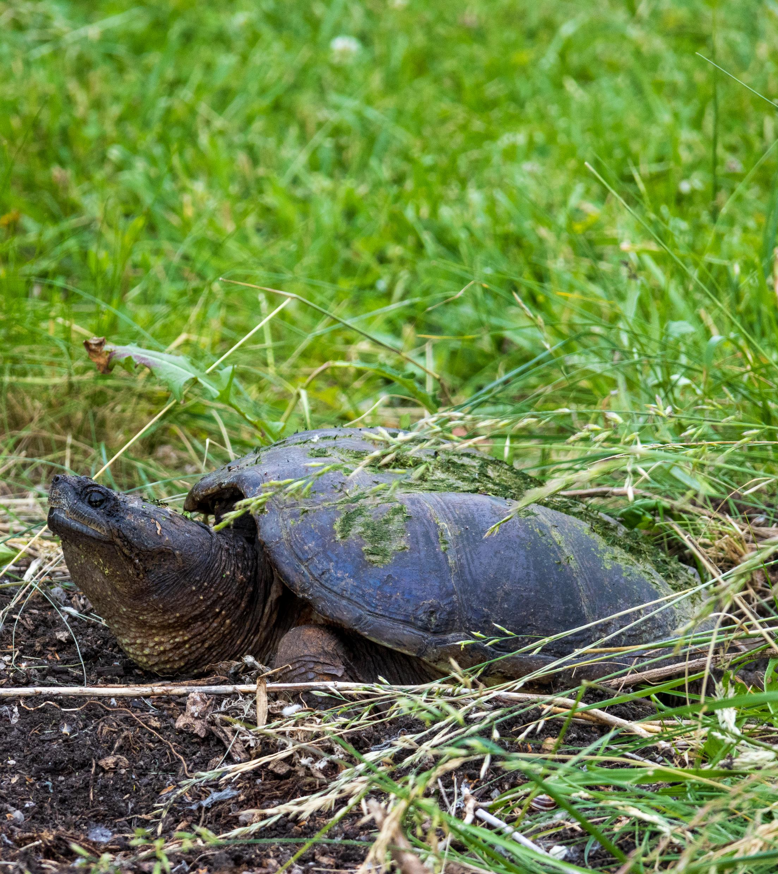
Walk around the wetlands, paying close attention to the nesting site locations identified in the previous slide and complete the Microsoft Form to the best of your ability
Look for Snapping Turtles actively nesting
Look for evidence that a Snapping Turtle has already nested
  Snapping Turtles will dig many test holes before deciding on a nesting site. A test hole will be a deep hole dug into the soil
  A nesting site will be a large area of disturbed soil that the snapping turtle has moved soil back over the eggs with her back legs

Slide 8
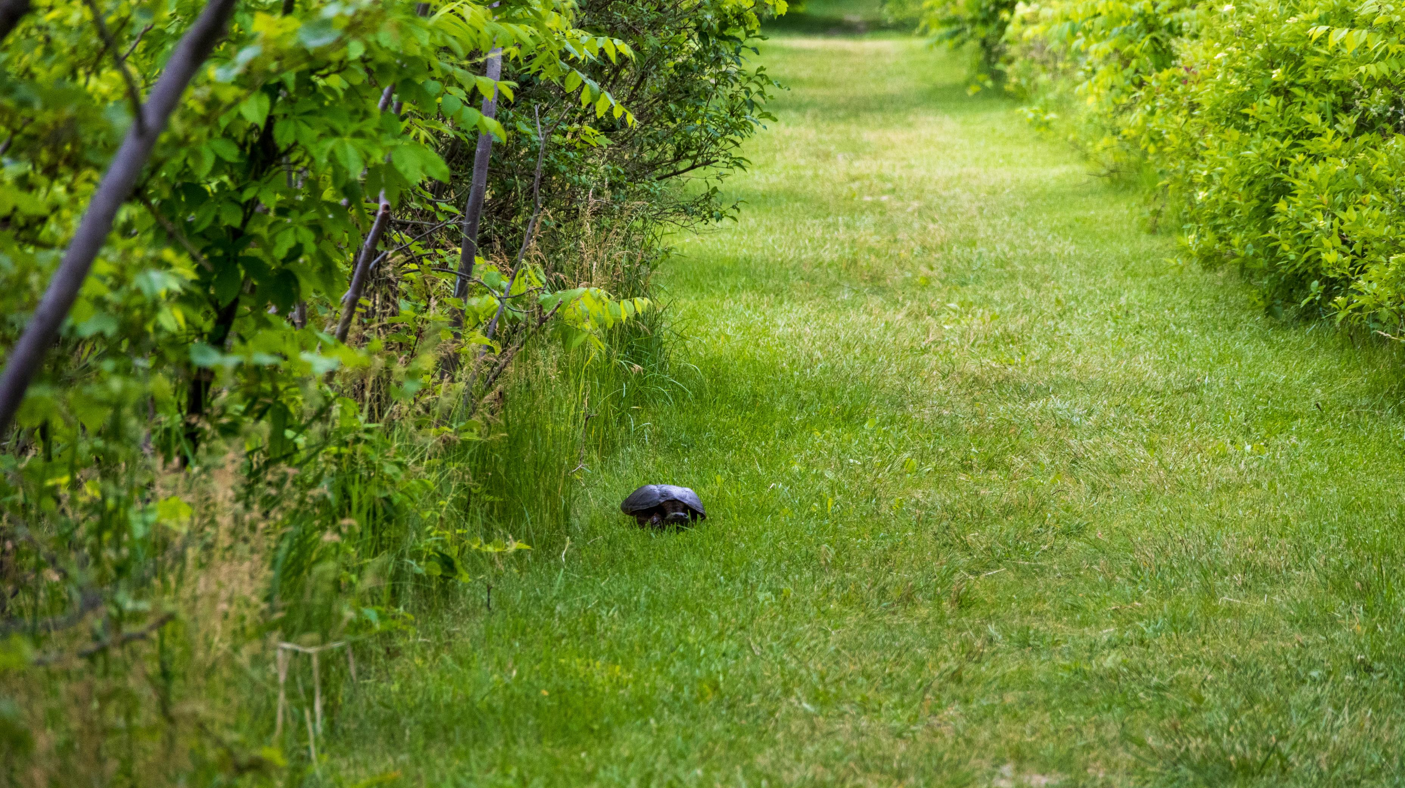

Slide 9
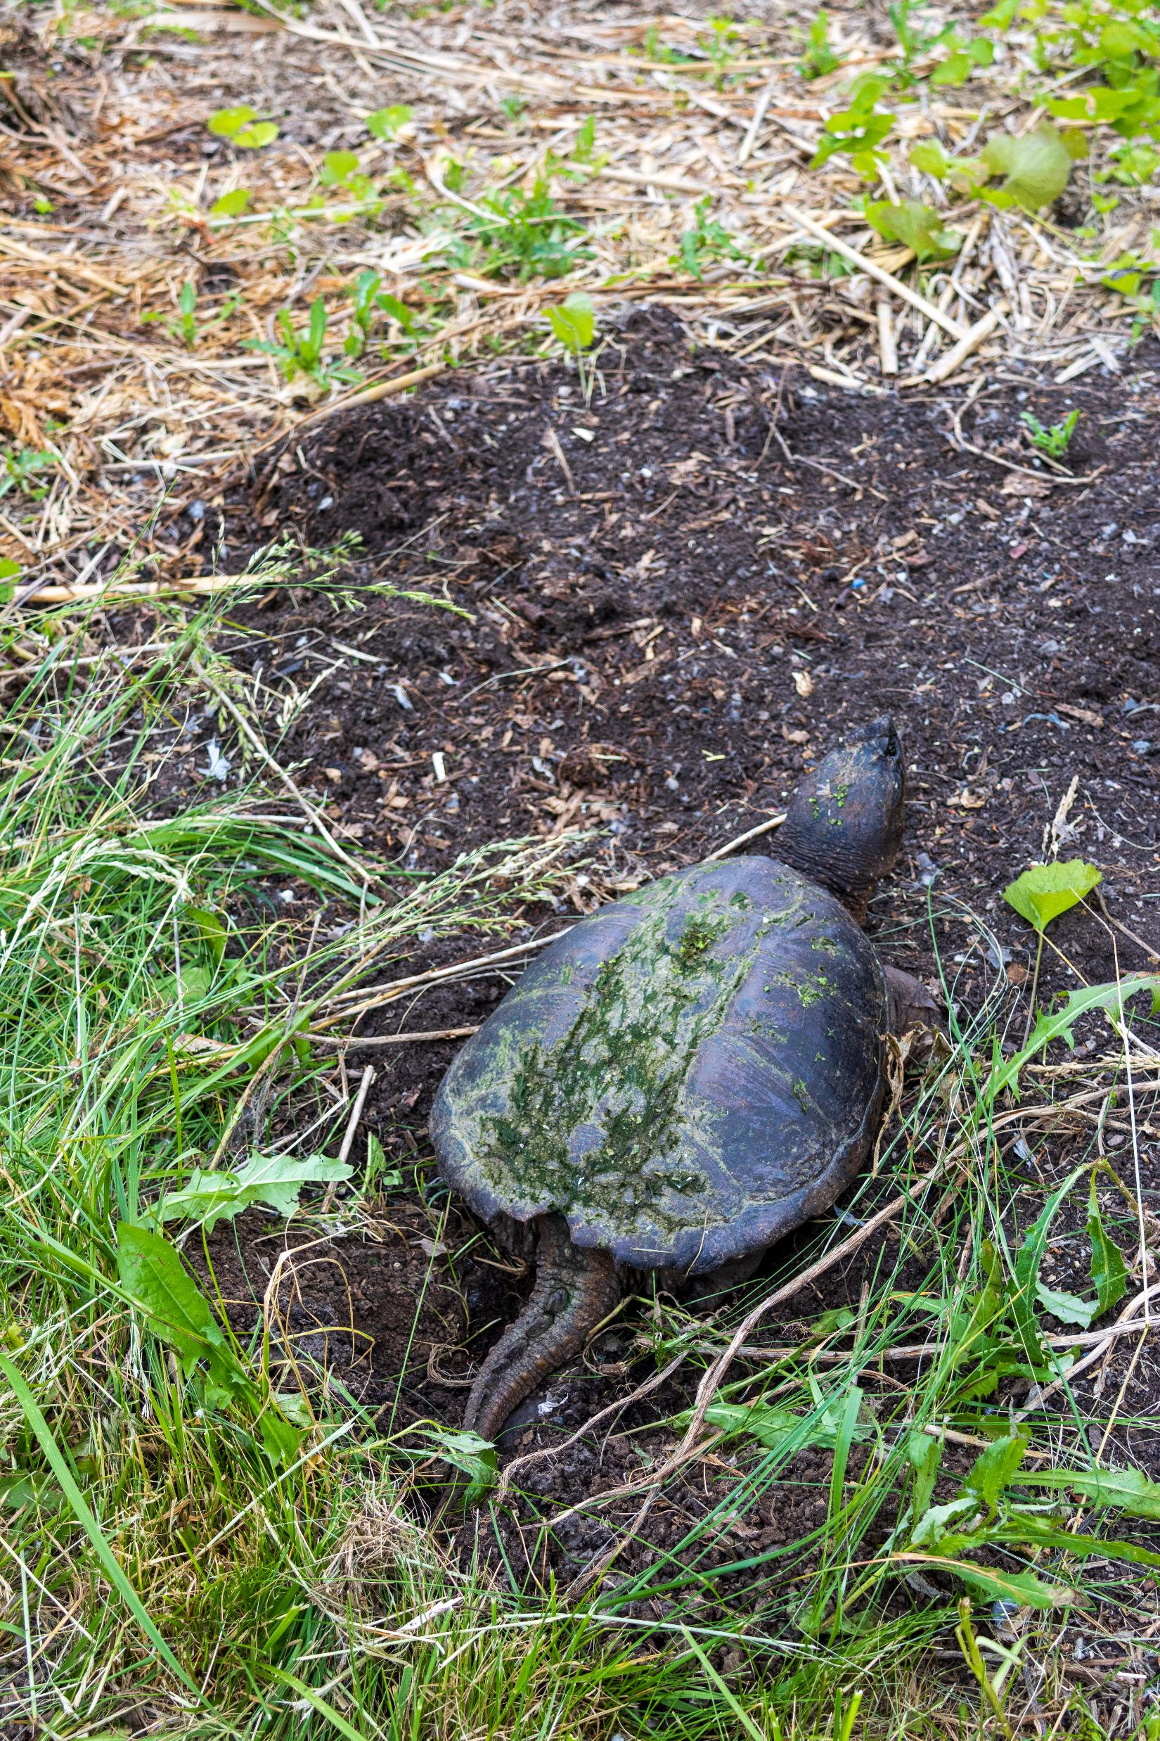
How can you tell a Snapping Turtle is nesting?
You may come across Snapping Turtles that are digging test holes or are looking for suitable nesting sites.
The process of digging the hole, laying eggs, and covering up the hole is a very hard process on the turtle, and laying of eggs typically takes 1-3 hours.
A Snapping Turtle on disturbed soil for a long period of time, even with people walking past it is good evidence that the turtle is laying eggs or has laid eggs.
  If the Snapping Turtle can sense that you are close, it will crouch closer to the ground and try to make itself smaller and minimize its movements.

Slide 10
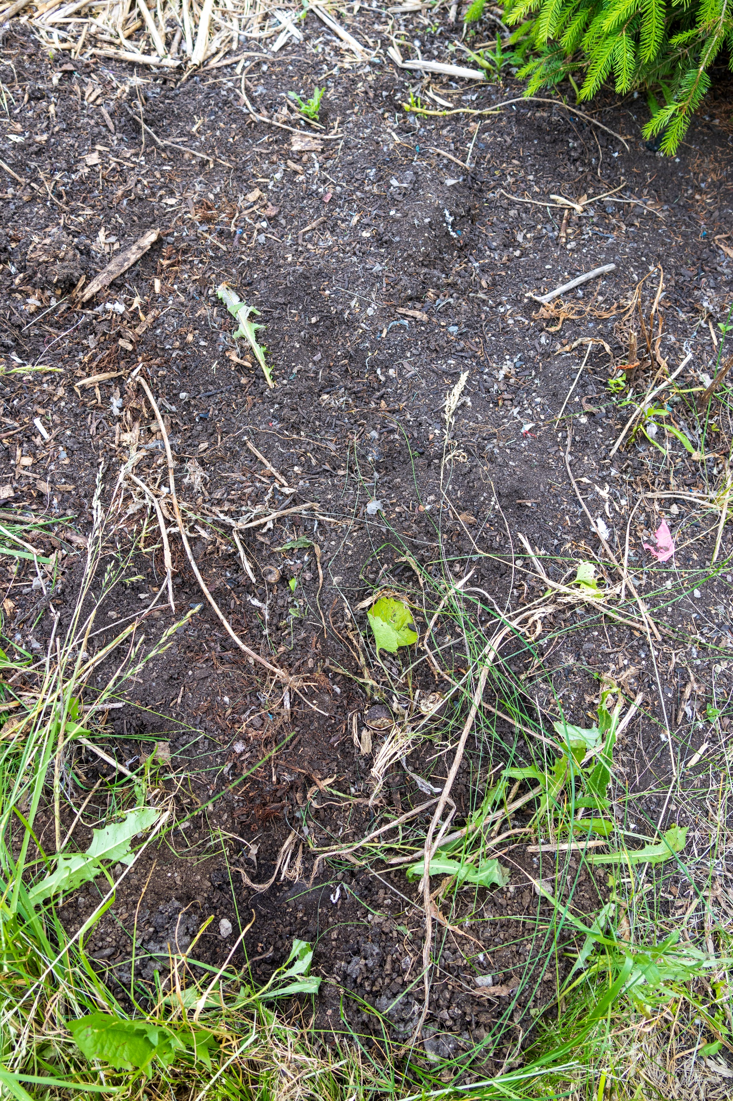
You can confirm a turtle has laid eggs by gently moving the soil in the area where you think it has laid, please see the turtle egg size and shape on the next slide to confirm species
If you have confirmed the presence of eggs, or strongly suspect the turtle has laid, despite lack of finding eggs, place the turtle nest protection cage over where you think the eggs are located.

Slide 11
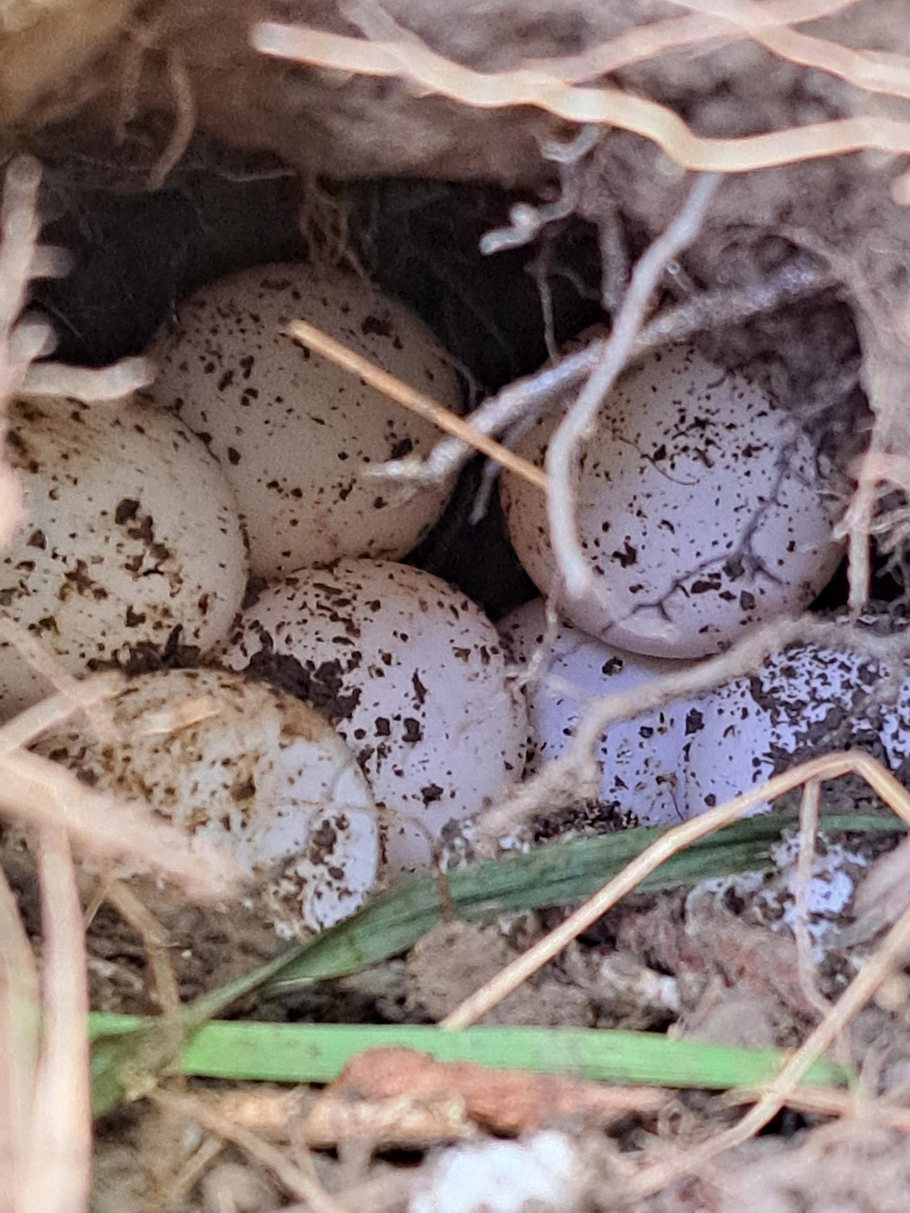
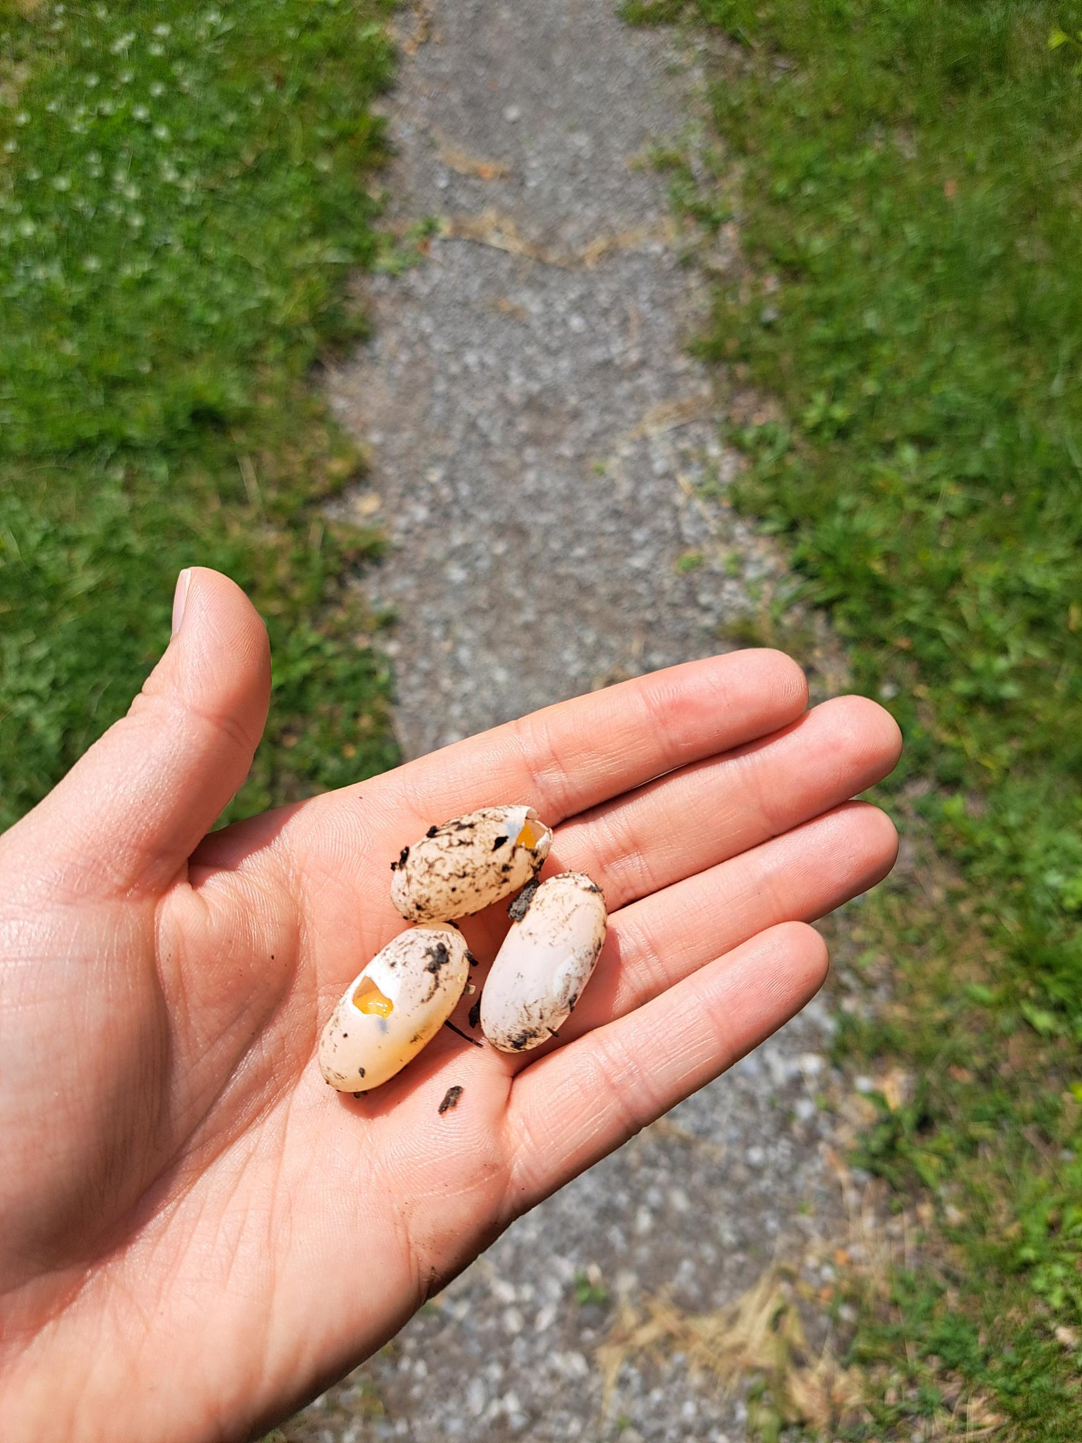
Snapping Turtle eggs, note the round egg shape
Painted Turtle eggs, note the oval egg shape

Slide 12
2023 Timeline
We are expecting timelines to move up 2 weeks due to weather
May 23rd
.
.
Baby painted turtle hatched.
June 6th
.
.
First snapping turtle nesting in the Three Sisters Garden!
June 12th
.
Found a half-predated snapping turtle nest in the Three Sisters Garden.
May 15th
.
First day of weeding and phragmites removal at the turtle beaches. Two baby painted turtles hatched.
May 24th & 25th
.
.
Construction of turtle nesting cages.
June 7th
.
.
Snapping turtle nesting at turtle beaches.
June 14th
.
.
Snapping turtle nesting at turtle beaches.
Notes:
Rachelle
This slide shows a timeline of our work from mid-May to mid-June.
May 15th was the first day of weeding and phragmites removal at the turtle beaches. This was completed to create space for the turtles to nest. Weeding and phragmites removal occurred at least once weekly for the entire duration of the turtle nesting period so that the turtles had access to a place to nest.
In addition, two baby painted turtles hatched at the South turtle beach on May 15th. One lived, and unfortunately, one died.
On May 23rd another baby painted turtle hatched from the same location at the South turtle beach and it lived.
Construction of our six turtle nesting cages occurred on May 24th & 25th. Immediately after the cages were completed, one was placed over the painted turtle nest at the South turtle beach.
On June 6th, the first snapping turtle nesting was observed in the Three Sisters Graden in the Indigenous Garden! A turtle nesting cage was used to protect the turtle nest.
On June 7th, a snapping turtle nesting was observed at the South turtle beach. A turtle nesting cage was used to protect the turtle nest.
On June 12th, a half-predated snapping turtle nest was found in the Three Sisters Garden in the Indigenous Garden. Again, a turtle nesting cage was used to protect the remaining eggs.
On June 14th, a snapping turtle nesting was observed at the South turtle beach. A turtle nesting cage was used to protect the turtle nest.
Finally, on June 22nd a snapping turtle nest was found under the phragmites pile when the pile was being removed. A turtle nesting cage was used to protect the turtle nest.

Slide 13
2024 Timeline
June 2nd
.
.
First Snapping Turtle nest protected at the Indigenous Gardens
June 7th
.
.
Snapping Turtle nesting along Taylor Road
June 18th
.
Painted Turtle nested in the Indigenous Garden.
May 14th
.
First Snapping Turtle spotted looking for suitable nesting site
June 3rd
.
.
Multiple Snapping Turtles nesting.
June 9th
.
.
Snapping turtle nesting at the Turtle Beaches
July 4th
.
.
Painted turtle nesting on the trail located by the Indigenous Garden
Notes:
Rachelle
This slide shows a timeline of our work from mid-May to mid-June.
May 15th was the first day of weeding and phragmites removal at the turtle beaches. This was completed to create space for the turtles to nest. Weeding and phragmites removal occurred at least once weekly for the entire duration of the turtle nesting period so that the turtles had access to a place to nest.
In addition, two baby painted turtles hatched at the South turtle beach on May 15th. One lived, and unfortunately, one died.
On May 23rd another baby painted turtle hatched from the same location at the South turtle beach and it lived.
Construction of our six turtle nesting cages occurred on May 24th & 25th. Immediately after the cages were completed, one was placed over the painted turtle nest at the South turtle beach.
On June 6th, the first snapping turtle nesting was observed in the Three Sisters Graden in the Indigenous Garden! A turtle nesting cage was used to protect the turtle nest.
On June 7th, a snapping turtle nesting was observed at the South turtle beach. A turtle nesting cage was used to protect the turtle nest.
On June 12th, a half-predated snapping turtle nest was found in the Three Sisters Garden in the Indigenous Garden. Again, a turtle nesting cage was used to protect the remaining eggs.
On June 14th, a snapping turtle nesting was observed at the South turtle beach. A turtle nesting cage was used to protect the turtle nest.
Finally, on June 22nd a snapping turtle nest was found under the phragmites pile when the pile was being removed. A turtle nesting cage was used to protect the turtle nest.

Slide 14
Proper Installation of the turtle nest cage protector
Place the middle of the cage protector over the area where the eggs are located
Wiggle the cage a bit so it is pushed down closer to the ground, making sure there are no exposed areas for a predator to reach under
Put four of the garden stakes into the chicken wire as close to the edges of the frame as possible and push into the soil
  If the soil is too dry/hard use a rock or available material to hammer the stakes into the ground, this is to prevent predators from moving the cage to access the eggs

Slide 15
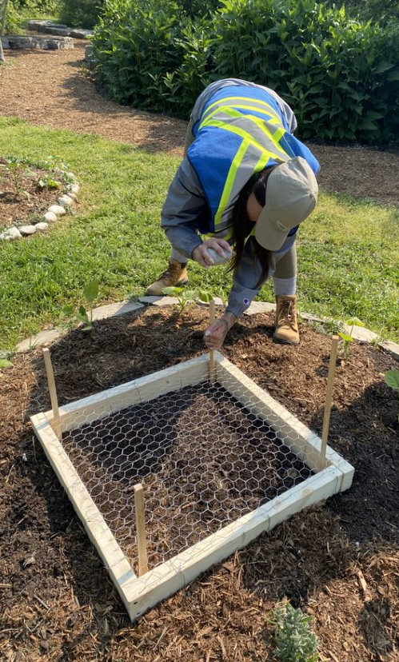
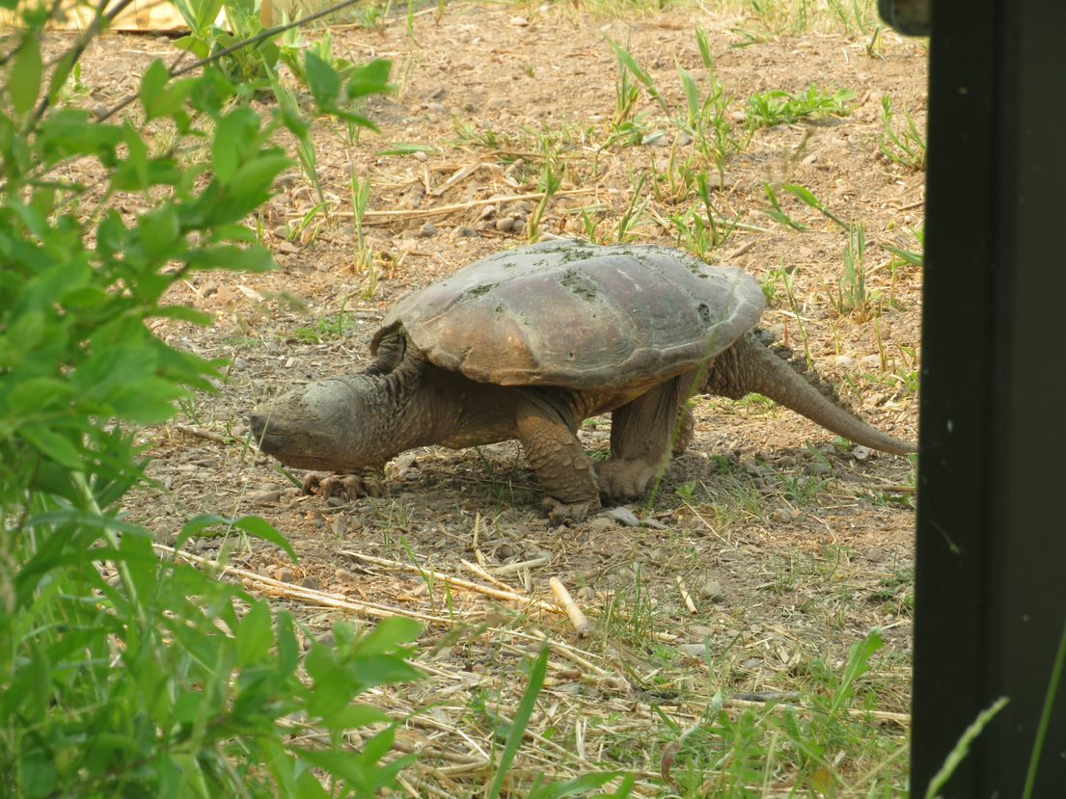
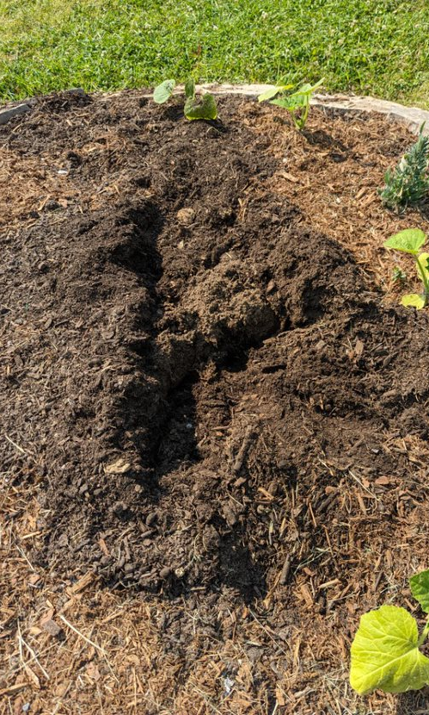
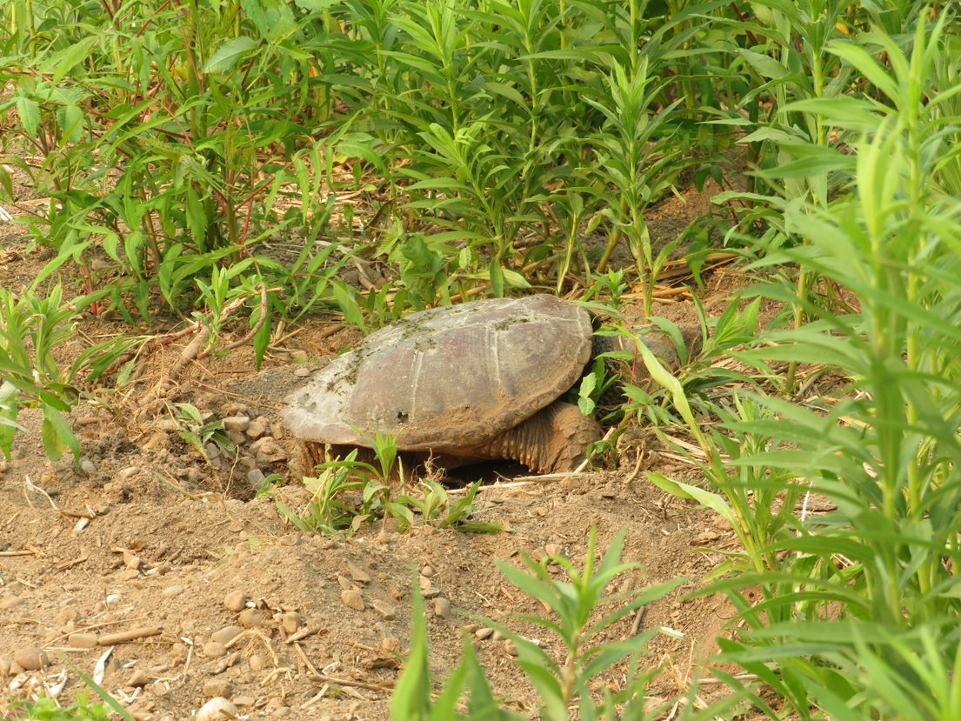
Notes:
Sierra
Left > Student Sustainability Technician Rachelle pounds stakes into the ground to hold a turtle nesting cage in place.
Top middle > Female snapping turtle leaving her nest at the South turtle beach.
Bottom middle > Female snapping turtle nesting at the South turtle beach.
Right > How a snapping turtle nest looks once it is completed and covered by a snapping turtle. Snapping turtle nests can be difficult to spot because as seen in the photograph on the right, the only sign of a snapping turtle nest is disturbed soil.

