Slide 1
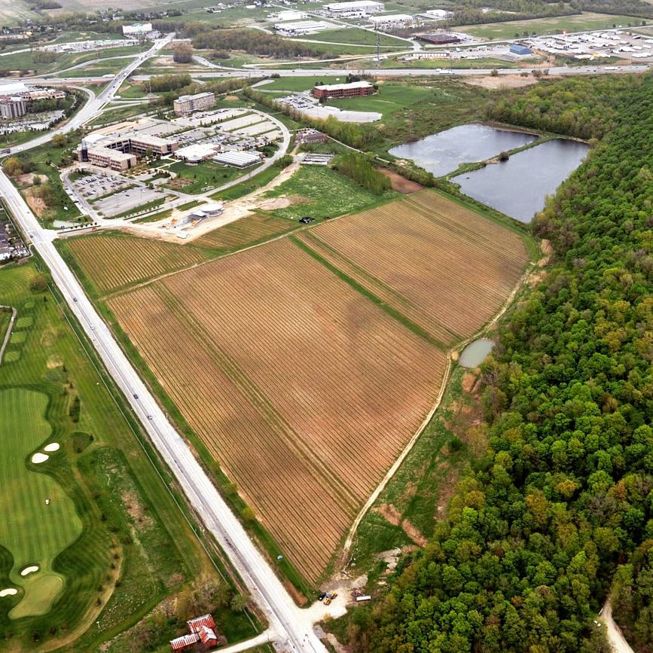


An introductory waste training module for Niagara College students, staff, and faculty
An introductory waste training module for Niagara College students, staff, and faculty.
Notes:
Hello and Welcome to the Introductory Waste Training Module for Niagara College.
My name is Amber Schmucker, I am the Sustainability Outreach and Program Coordinator, and I will be leading you through this training module today. This training is meant to provide students, staff, and faculty with the base knowledge needed to navigate the waste management system at both the Daniel J. Patterson and Welland campuses.

Slide 2
Stakeholder Appreciation
Niagara College recognizes that Facilities Maintenance Staff are integral to all operations, especially waste management.
As a Niagara College community, we all can play a role in the success of our waste management strategies.
Notes:
Before we begin, I want to start by thanking you for taking the time to complete this module. As members of the Niagara College community, we all play an important role in the success of the college’s waste management system.
I would like to take this time to acknowledge the integral role that Facilities Management Services and our campus cleaning contractors play in the day-to-day waste operations and management.

Slide 3
Learning Outcomes
In this module you will learn:
How to define waste.
About Waste Management at Niagara College.
How to sort your waste on campus.
About waste regulatory compliance in Ontario.
How our thinking of waste is shifting.
Notes:
Through this module you will learn:
How we define waste at Niagara College
The waste management strategies and practices at Niagara College
How to sort your waste on campus
The reason that we have this programming at the college
How our thinking of waste is shifting

Slide 4
Waste Defined
What is waste?​
Any type of unwanted material or substance that results from human activity. Sometimes this material can be reused. Once this material has reached the end of its life cycle it enters a waste stream.
Notes:
Typically, when most of us think of waste, our minds go straight to landfills and garbage. This, however, is misleading. At Niagara College we define waste as:
Any type of unwanted material or substance that results from human activity. Sometimes this material can be reused. Once this material has reached the end of its life cycle it enters a waste stream.
This means that anything we no longer want is ‘waste’. Even when these items can be reused. Once we decide to get rid of something it is disposed of in a waste stream.

Slide 5
NC Waste Management
What is Waste Management? ​
A comprehensive waste reduction, recycling, composting, and landfill disposal program.​
Promotes diversion of waste from landfills through
waste sorting systems into the appropriate waste streams:​
Recycling ​
Landfill​
Organics
Notes:
As we wrap our minds around what waste is it is easy to get lost in how many activities are involved with waste management. At Niagara College we see Waste Management as:
A comprehensive waste reduction, recycling, composting, and landfill disposal program.
This program is meant to divert waste from landfills through waste sorting systems by means of waste streams. If you have had the chance to walk around the college campuses, you will notice that we have three different waste streams for waste disposal. This includes recycling, organics, and landfill.

Slide 6
Waste Streams
What are waste streams?
The entire life cycle of the waste we produce. From putting it into the recycling, organics, or landfill bin for pickup to transport to landfill, recycling, and composting facility.​
The waste stream is defined by its end destination.
Notes:
You may have noticed our hallway waste receptacles while walking around campus. This is our source separation program (more on that later!) that has 4 waste bins, representing 3 waste streams. Confused? Let me explain further.
Front of house at both campuses (i.e., the hallway waste receptacles) we have four disposal bins representing the streams that mark the beginning of the waste journey for most items. These bins are recycling, organics, landfill, and coffee cups. Once the waste bins are collected by our campus cleaning staff, it is transported back of house and sorted into its respective landfill, recycling, or composting dumpsters or totes.

Slide 7
Waste Contamination
What is waste contamination?
Waste contamination happens when waste items are not properly disposed into the respective disposal bin. When waste contamination occurs, it disrupts the effectiveness of the materials’ waste stream.
Avoid waste contamination by following NC waste sorting practices, keeping current on what goes where, and reaching out to the Office of Sustainability if you have any questions.
Notes:
What is waste contamination? Why does it matter?
When items are not disposed of in the proper bin, this causes waste contamination. When this occurs, it can cause downstream impacts at the respective disposal facilities.
You can help stop waste contamination by taking this module, using our online resource: What Bin Do I Put It In?, and when in doubt, reaching out to the Office of Sustainability through email.

Slide 8
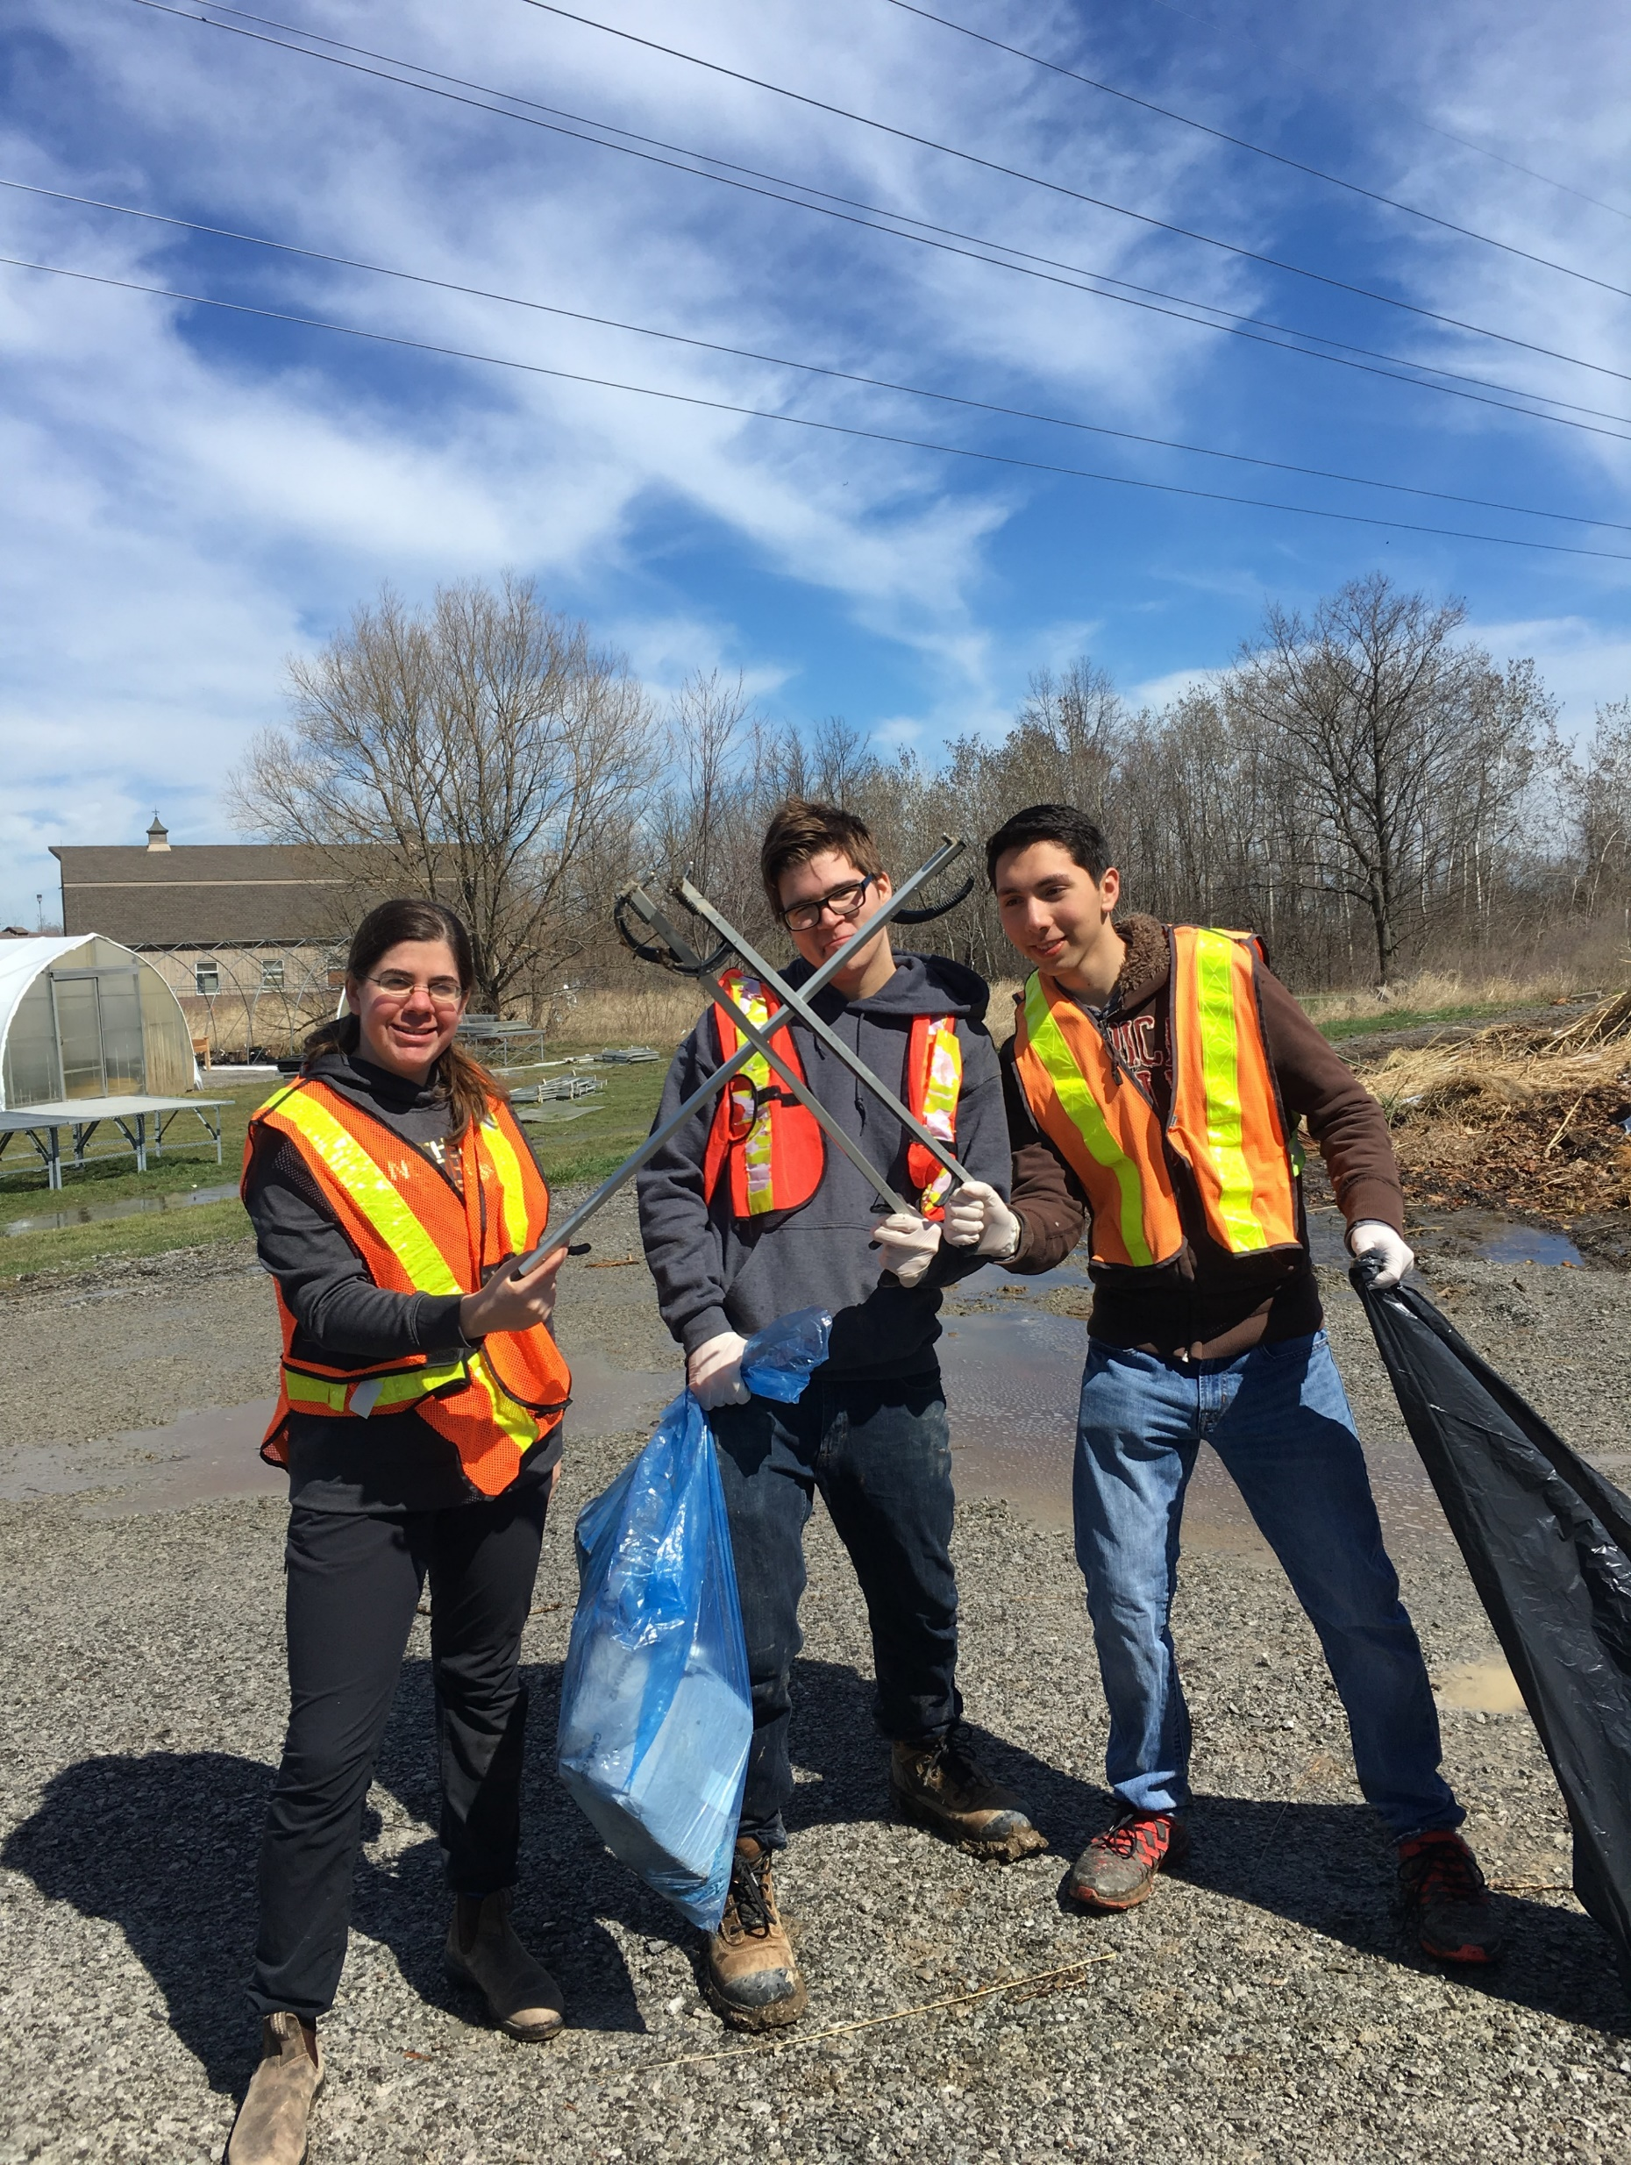

CHECK-IN ACTIVITY
What Goes Where?
Click here to skip the activity.
Notes:
Now that we are familiar with the waste management system on campus let us check in with a fun activity. On the next slide you will see labelled and colour coded ‘bins’. These are representative of the waste streams throughout the hallways on campus (need a refresher? Refer back to slide 6: Waste Streams).
Now onto the activity!
Common waste items that can be found on campus are shown as small images on the top right of the slide. When the item pops up you are encouraged to choose where the item would go. Click and see if you are correct. This is just a check-in to see how confident you are with the waste system at NC. If you don’t want to participate in the activity and feel confident in your ability to sort on campus, or if you learn in a different way, click on the skip activity link at the bottom of this slide.

Slide 9

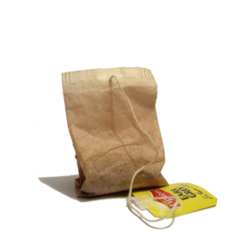
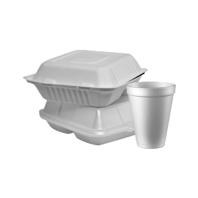


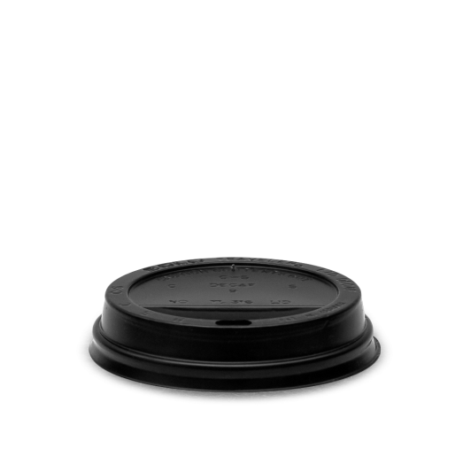




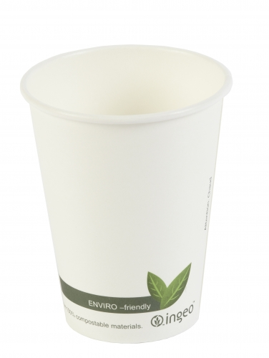
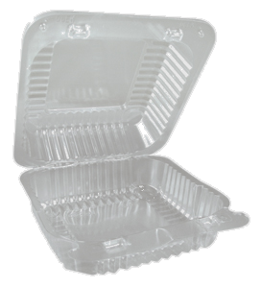





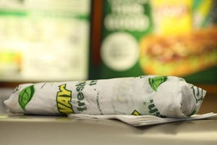


What Goes Where?
Recycling
Landfill
Coffee Cups
Organics
Notes:
Read, Set, Go!

Slide 10
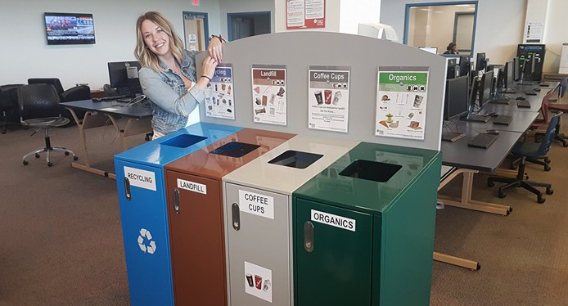
NC Waste Streams
Niagara College has 3 Waste Streams:​
1. RECYCLING​
2. LANDFILL
3. ORGANICS
Notes:
Now more on the NC waste streams.
As previously mentioned, Niagara College has a three-stream waste system on campus represented by four bins: blue bin for recycling, brown bin for landfill, grey bin for coffee cups, which is destined for landfill, and green bin for organics. Please note our on-campus waste management system might differ from what you are familiar with at home. For details or questions about your at home waste management practices visit your municipality’s website.

Slide 11

Recycling
Recycling
Recycling
Major Recycling CONTAMINANTS
COFFEE CUPS – remove lid and sleeve and place in RECYCLING and put cup in COFFEE BIN​
FOOD WASTE - empty all food waste in ORGANICS​
CHIP BAGS/FOOD
WRAPPERS - put in LANDFILL​
Notes:
When you approach a waste sorting unit, you will notice a blue poster such as the one on the screen. At NC we have a single stream recycling system. That means that all recycling items, cans, plastics, paper, glass, all go in one bin; then later are sorted at a recycling facility. This differs from Niagara’s curbside pick-up where papers are separated and collected in a different bin.
DYK that plastics are numbered? We accept plastic 1 through 7. Each number represents a type of recyclable plastic. For example, a plastic that you may be familiar with is plastic #1, or polyethylene, commonly used in plastic water and pop bottles. Another common plastic, plastic #6, or polystyrene, is typically recognized by the brand Styrofoam! Plastic #6 is also often used to manufacture coffee cup lips!
It should be noted that some plastics are more recyclable than others. To find out what # your plastic is, look for the recycling symbol, called the Mobius loop, on your waste item. If you cannot find this number, your item is destined for landfill. For example, chip bags, plastic film, and plastic containers, CAN be destined for the landfill if you cannot find the Mobius loop with number 1 through 7 on your item.

Slide 12
Recycling Top Tips
Plastic utensils with a recycle symbol and 1-7 can be recycled
Cans and cartons must be empty before discarding
Dry and clean bags, paper towels, and napkins can be recycled
Bundle plastic bags (grocery bags) before disposing
Visit What Bin Do I Put It In? for more sorting information.
Notes:
Sometimes it can be difficult to tell what is recyclable and how to recycle. The Office of Sustainability has developed a user-friendly guide called What Bin Do I Put It In? to make sorting easier for everyone.
You can find this resource through the Office of Sustainability Website at niagaracollege.ca/sustainability
Here are some of our top recycling tips to make recycling easier on-campus:
Plastic utensils with a recycle symbol and a number between 1 through 7 can be recycled
Cans and cartons should be emptied before discarding
Dry and clean paper bags, paper towels, and napkins can be recycled

Slide 13
Single-use Coffee Cup Bin
Single-use coffee cups are one of the top contaminants in the waste streams on campus​. NC has adopted a Single-use Coffee Cup Bin as part of the source separation program.
Coffee cups are not recyclable and go to the landfill​.
Lids and sleeves are recyclable​.
The Single-use Coffee Cup Bin encourages users to separate the recyclable lids and sleeves from the non-recyclable cups to divert waste from landfill and reduce contamination in the recycling bins.
Notes:
After a thorough review of the waste generated and disposed of at Niagara College, a study found that single-use coffee cups were one of the top contaminants in the waste streams. As a waste reduction strategy, Niagara College has adopted the Single-Use Coffee Cup bin as part of our source separation program.
As we saw in the Check-in Activity, when you approach a waste sorting unit with the three waste streams: recycling, organics, and landfill, you will see a fourth grey bin for your single-use coffee cups.
Single-use Coffee Cups are not recyclable on-campus and are added to the landfill stream before being sent to a landfill facility. The lids and sleeves are recyclable and should be disposed of in the recycling bins.

Slide 14
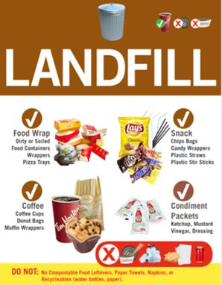
Landfill
Major Landfill OFFENDERS
FOOD WASTE –
Place in ORGANICS bin​
NAPKINS & PAPER TOWELS – Place in ORGANICS bin​
PLASTIC BOTTLES –
Place in RECYCLING bin
Notes:
Everything that can’t go to the other streams will end up in the landfill. Through our source separation program, we contribute to capturing valuable resources, and reducing the greenhouse gases emissions generated from certain food and organic waste items. When we sort our waste, we are helping to fight climate change.

Slide 15
Landfill Top Tips
Empty blister and medication packs go to the landfill
Discard empty food wrappers (i.e., chips, granola bars, etc.)
Plastic utensils without a recycle symbol with number 1-7
Discard plastic wrap and waxed paper in the landfill stream
Visit What Bin Do I Put It In? for more sorting information.
Notes:
When we are unsure of where to dispose of an item or substance, our instinct might be to put everything in the landfill bin. If you aren’t sure where to put your waste, there are amazing resources on campus to help you properly sort your items.
Using the waste posters and online guide are fantastic ways to divert away from the landfill stream and reduce our overall impact. Additionally, you can always reach out to the Office of Sustainability by emailing us at sustainability@niagaracollege.ca.
When in doubt here are our top tips for disposing your landfill waste:
Remove and dispose of food waste to the organics bin from food wrappers. The empty food wrappers then go in the landfill bin.
If you do not see a number between 1 through 7 on your plastic item, such as utensils, it goes in the landfill bin
Plastic wrap and waxed paper are also destined landfill stream.

Slide 16

Organics
Organics
Major Organics CONTAMINANTS
COFFEE CUPS - remove lid and sleeve and place in RECYCLING and put cup in COFFEE BIN​
COFFEE SLEEVE - put in RECYCLING​
NEWSPAPER - put in RECYCLING​
CARDBOARD - put in RECYCLING​
Ontario Food Waste Framework
Notes:
Organics recycling programs are still relatively new in post-secondary institutions. Food waste is heavy and takes up a lot of room in landfills, making it an important part of the waste management systems at NC. A framework for reducing food waste to landfill has been developed in the province of Ontario. For more information about the Provincial Organics goals, we encourage you to read the Ontario Food Waste Framework.
DYK? It is a common misconception that our organics are composted on site. The College’s organics stream is industrially composted off site; that is the reason we can accept different proteins and paper products in our four stream bins. You typically wouldn’t put meats and bioplastics in your compost unit at home.

Slide 17
Organics Top Tips
Wet or soiled bags and coffee cup trays can be composted
Dairy items can go in the organics bin without a container
Compost wet and soiled paper towels, napkins, and bags
Wooden stir sticks can be composted
Visit What Bin Do I Put It In? for more sorting information.
Notes:
When we think of organics our minds can go straight to food. There are, in fact, other items that can be disposed of in the organics bin on-campus. Some of these other items include:
Wet or soiled bags and coffee cup trays
Dairy items without a container
Wet and soiled paper towels, napkins, and bags
And finally, wooden stir sticks
As with recycling more sorting information can be found on the What Bin Do I Put It In? guide online.

Slide 18
Special Cases
E-Waste
Battery Bins
Learn more about waste sorting at:
NC Sustainability – What Bin Do I Put It In?
NC Waste Management System
Notes:
There are a few special cases that you may experience while on a Niagara College campus. I’ll take this opportunity to share a couple examples with you.
IF you have an electronic that breaks on campus, you are encouraged to bring it to your local E-waste drop off location.
If you have batteries and are looking for a place to dispose of them, we have Battery bins located in the library at both campuses.
For more detailed information about the NC waste management system visit our website: https://www.niagaracollege.ca/sustainability/projects/waste-engagement-strategies/

Slide 19
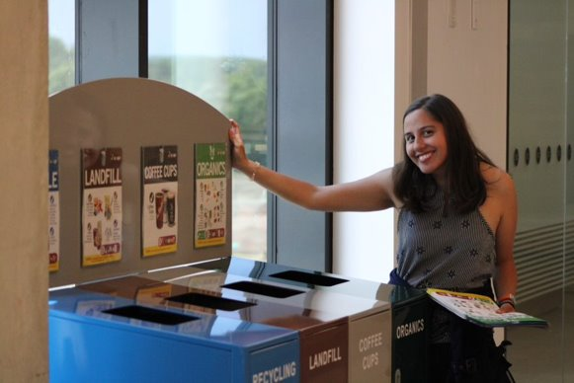
CHECK-IN
ACTIVITY
Quiz
Click here to skip the activity.
Notes:
Want to test your knowledge? Go to the next slide for a quick waste quiz. Feeling like an expert already? Click the dialogue box at the bottom of the screen to continue with this module.

Slide 20
Quiz
1. Niagara College has four waste streams.
FALSE – Niagara College has three waste streams. The grey Coffee Cups bin is added to the landfill stream.
2. All plastics can go in the blue Recycling bin.
FALSE – Only plastics with the recycle symbol and a number of 1 through 7 go in the recycle bin.
3. Food waste and soiled paper products go in the green Organics bin.
TRUE – Remember: properly sort your food wrapper/container!
Notes:
Try to answer the true or false question on the screen. Once you have tried the question click to reveal the answer.

Slide 21
Waste Targets
Sustainability Policy
"Niagara College aims to develop a culture of sustainability and integrate the broad concept of sustainability within the college community. The Niagara College Policy will be a driving force and support the growth of
sustainable development for Niagara College."
Notes:
“At Niagara College, sustainability means providing high-quality applied education and training that meets the needs of students, employees, and the communities in which we operate today while protecting and enhancing the human and natural resources that will be needed in the future.”
We believe that by fostering this culture of sustainability, we can reduce our waste and reach our specific objective of reducing waste generation and increasing efficiencies in services and operations.

Slide 22
Waste Targets P1
Sustainability Plan 2019-2021
OBJECTIVE:
Reduce waste generation and increase efficiencies in services and operations.
GOAL 1 (3A): Reduce absolute waste sent to landfill.
GOAL 2 (3A): Increase waste diversion rate.
GOAL 3 (3A): Increase food waste capture rate.
TARGETS:
• Reduce waste sent to landfill by 10% from 2012
• Achieve a diversion rate of 65%
• Achieve an organics capture rate of 70%
Notes:
To achieve this objective, we have set out key targets. These include:
Reduce waste sent to landfill by 10% from 2012
Achieve a diversion rate of 65%
Achieve an organics capture rate of 70%
Want more information about what these targets mean? Click the link ‘Sustainability Plan 2019-2021’ for more information.

Slide 23
NC Waste Audit
What is a Waste Audit?
A waste audit is a survey of the waste streams. This information is
used to assess how well the waste streams are performing and
whether Niagara College is maintaining regulatory compliance.
Find the Niagara College Waste Audits Online here.
Notes:
We measure these targets through a series of Waste Audits.
A waste audit is a comprehensive annual study of waste on campus. This information is used to assess how well the campus waste programs are performing and to stay in compliance with relevant regulations.
Review this after we decide whether we're keeping the previous slides.

Slide 24
Regulatory Compliance P1
Ontario Regulation 103/94:​
Any institution with a population >350 students to use a source separation program to encourage staff and students to dispose of waste in the proper bin to increase reuse and recycling.​
Niagara College’s source separation program =
Four Source Separation Waste Bins
Notes:
There are two relevant regulations for Niagara College.
These include:
Ontario Regulation 103/94:​
This states that:
Any institution with a population >350 students are to use a source separation program to encourage staff and students to dispose of waste in the proper bin to increase reuse and recycling.​
Niagara College’s source separation program are the Four Source Separation Waste Bins we discussed earlier.

Slide 25
Regulatory Compliance
Ontario Regulation 102/94:​
Educational Institutions must perform a waste audit.​
Click here for Niagara College’s latest Waste Audit Report.
More information about Waste Audits can be found on
the NC Sustainability website.​
Notes:
The second relevant regulation is:
Ontario Regulation 102/94
This states that:
Educational Institutions must perform a waste audit.​ Click on the hyperlink here for Niagara College’s latest Waste Audit Report.
More information about Waste Audits can be found on the NC Sustainability website.​

Slide 26
Shifting our Thinking about Waste
Compliant waste management is complex with social, environmental, and economic consequences.
The best waste management is reducing our consumption before it becomes waste.
Notes:
Waste management is an essential element of a sustainable future. Compliant waste management is complex with social, environmental, and economic consequences.
Moving forward we want to encourage the Niagara College community to shift our thinking about waste. The best waste management practice is reducing our consumption before it becomes waste.

Slide 27






Waste in a Global Context
An example of how we connect the SDGs and the NC Waste Management Training
UN SDGs
Waste Management Training Contribution to achieving the UN SDGs | Proper sorting and diversion of waste increase the reusability and resale of waste as resources. | Reduces waste generation through prevention, reduction, recycling and reuse. | Waste diversion from landfills reduces methane and carbon dioxide emissions. | Less plastic pollution to underwater life. | Less waste generation requires less landfill space.
Click on the UN SDG icon to connect to the UN SDG webpage for more information!
Notes:
Curious how NC Waste Management connects with waste in a broader global context? Click on the Sustainable Development Goals to learn more.

Slide 28
Waste Training Quiz
Click here to begin the Waste Training Quiz.
At the end of the quiz, you will have the opportunity to be entered a draw for a chance to win a $50 gift card to a business of your choice*.
*Select businesses only.
Notes:
We appreciate that you’ve made it to the end of our waste training module. We have prepared a quiz to test what you’ve learned from this training. By completing the quiz, you will be prompted to share your email address for a chance to win a $50 gift card of your choice from select businesses. Thank you for taking part in this waste training module.
We hope you enjoyed it. Don’t hesitate to reach out to the Office of Sustainability with any of your waste related questions.

Slide 29
Resources
Resources
NC Sustainability Plan 2019-2021
https://sustainability.niagaracollege.ca/about/sustainability-plan-2019-2021/
NC Sustainability – Waste Projects
https://sustainability.niagaracollege.ca/projects/waste/
NC Sustainability – What Bin Do I Put It In?
https://sustainability.niagaracollege.ca/wastetable/
Notes:
For more waste resources we encourage you to visit the Office of Sustainability website at niagaracollege.ca/sustainability.
You can find the NC Sustainability Plan 2019-2021, other Waste Projects, and our handy waste sorting guide: What Bin Do I Put It In?

