Slide 1
Climate Change Action Plan
Notes:
Danielle
Good Afternoon Everyone, thank you for joining us for our presentation of the College’s Climate Change Action Plan

Slide 2
Agenda
Overview of Climate Change
Impacts of Climate Change to Niagara Region
Impacts of Climate Change to Niagara College
The Role Of Higher Educational Institutions
Where Niagara College Stands
Mitigation and Adaptation Strategies
Limitations
Next Steps and Conclusions
Notes:
By way of overview, I’ll begin by giving some context to what climate change is and how it affects people at the global, national, and local scales. Then go more into detail regarding how climate change will impact Niagara Region and Niagara College more specifically. Then explain the role of higher educational institutions in the fight against climate change as well as what the College has already done in response to climate change. We have developed recommendations for the College to consider to both mitigate or prevent the effects of climate change as well as some ways to adapt to the effects that are likely to occur. Finally we’ll conclude with the limitations we encountered as well as the College’s next steps from this Plan

Slide 3
Introduction
Global
National
Local
Notes:
Image Source: https://www.123rf.com/photo_78597355_the-word-climate-change-concept-and-theme-painted-in-colorful-watercolors-on-a-white-paper-backgroun.html
Even though we were focused on understanding how climate change could impact Niagara College specifically, we believe that understanding the larger context of climate change at the global and national scales is vital to truly being able to understand priority actions going forward. Climate change does not exclusively operate on local scales, so it was important that the Climate Action Plan be developed with the broader context in mind. A certain effect may not be seen in Niagara Region, but students that are not from the area could be dealing with different challenges when they return to where they are from, so the College must be sensitive to broader issues.
With that said, I’ll briefly explain the global and national contexts of climate change.

Slide 4

Global Climate Change
Notes:
The Intergovernmental Panel on Climate Change or IPCC has written extensive scientific reports on how climate change will impact the world in terms of temperature and precipitation changes. According to the IPCC, global average temperatures have already warmed 1-degree and if emissions are not significantly decreased the impacts of climate change could be severe. The Panel wrote a report to explain what changes the world could experience if the temperature rises 1.5 degrees. These changes interact to cause a wide-range of effects such as an increased occurrences of heat waves, intense precipitation, and extreme weather. Other global effects include sea level rise and ocean acidification. Many of these impacts are expected to disproportionately affect vulnerable communities.
While some of these effects may not be felt directly by the Canadian Niagara College campuses, the school welcomes international students from many different countries that could be experiencing these changes. It will be important to ensure the College is committed to adaptation and mitigation strategies as well as to education so that international students can be equipped to deal with different circumstances upon their return home.
Now that we understand some of the global context and the range of effects the world will experience, we can begin to focus

Slide 5
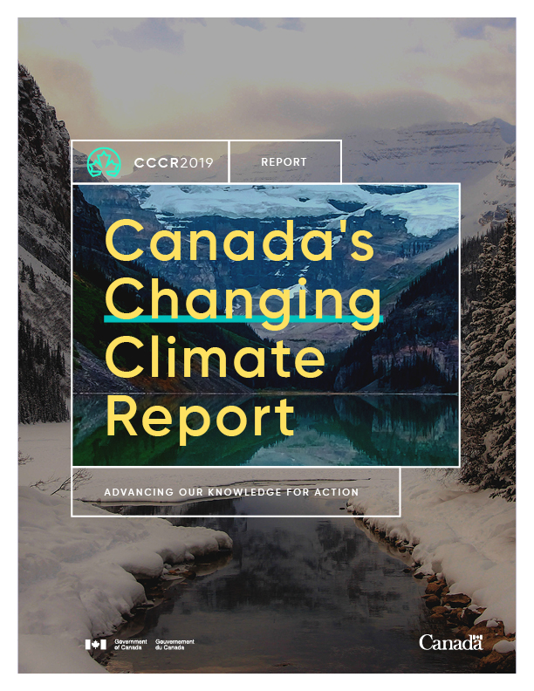
National Climate Change
Notes:
On a National Level, the Government of Canada has conducted research on how climate change will affect the country although it focuses more on sensitive areas such as the North. The Government of Canada assessed the possible impacts of climate change from two scenarios. The first was the “high emissions scenario” where carbon emissions throughout the country continue as normal. The second was a “low emissions scenario”. If emissions continue or increase, average temperatures across Canada could increase between 3-5 degrees. If emissions are reduced, warming could be kept under 2.5 degrees.

Slide 6
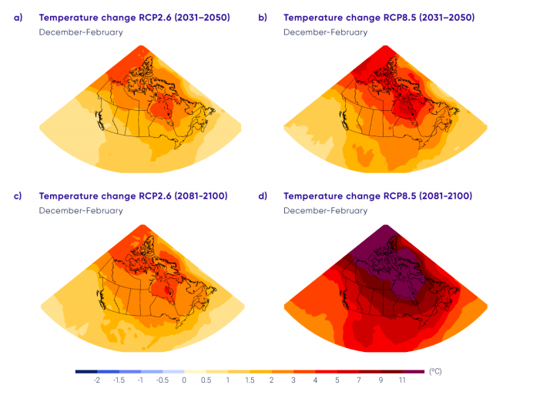
Notes:
From Canada’s Changing Climate Report, it is clear that Southern Ontario is expected to see increases in average temperature. This graphic from the report shows the projected increase in temperature over the winter. Panels a and c show low emissions scenario and panels b and d show the high emissions scenario. As you can see Canada’s North is expected to be affected the most, but southern Ontario could still experience warming as much as 1.5 degrees in the low emissions scenario or upwards of 5 degrees in the high emissions scenario.
Warmer winters are not the only expected effect of climate change. Southern Ontario is also expected to experience warmer summers with less precipitation and a higher frequency of extreme weather. These effects are the most likely to affect Niagara College and are the focus of the Climate Action Plan.

Slide 7
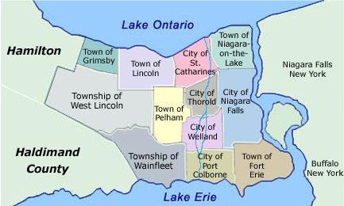
Climate Change impacts in the Niagara Region
Notes:
Image source: http://www.niagararealtysource.com/
Unfortunately, there is no as much research done on climate change at local scales. Ontario has a high-level action plan but has not published any research on how climate change will be experienced by smaller communities. Niagara Region published a report in 2012 that assessed how climate change could impact the region and there was limited research beyond that. Niagara College will need to examine its infrastructure to assess how resilient it is to
Even with limited research, we can still predict some of the possible impacts of climate change on the Region and Niagara College using the Federal and Regional Reports
As I pointed out earlier, Southern Ontario could experience warmer winters and potentially significantly warmer summers with less precipitation as well as more frequent extreme storms. Niagara College will need to consider how heat waves and storms could affect the College’s infrastructure as well as the Region’s infrastructure that so many students rely on. Dmitry will expand on how these effects might be felt throughout the Region.

Slide 8
Climate Change impacts in the Niagara Region
Impacts to Agriculture
Impacts from storms and extreme Weather
Impacts to Infrastructure
Impacts to the Transportation System
Impacts to Human Health and Wellness
Impacts to the Economy
Notes:
Unfortunately, many areas are affected by negative outcomes of climate change.
First of all, there are a lot of impacts on the agricultural sector, mainly due to the warmer average temperatures, heatwaves. As an example, less moisture for crops causes heat damage or the death of crops. Other examples include an increase in plant disease, increased number of pests and weed growth, shorter grain-filling period that result in decreased yields. In addition, the efficiency of some pesticides may be reduced.
Talking about storms and extreme weather, they also are likely to have the potential to significantly impact the agricultural sector in the Niagara Region - the examples include increased rainfall in winter and spring times that could delay planting and thus shorten the growing season. Other examples can be extreme rainfall and flood events that can physically damage crops and reduce oxygen levels in the soil.
The infrastructure will also be affected - higher temperatures combined with increased run-off stormwater may contaminate drinking water. In addition, the demand for electricity may be increased due to hotter temperatures that put stress on existing distribution infrastructure and due to increased evaporation that pose a challenge for hydroelectric generation.
As to the transportation system, shipping through canals may be decreased due to the lower water level. Public transport also will be affected by extreme weather. Talking about Human Health and Wellness, residents may face a lot of challenges resulted from the effects of climate change, such as dehydration, physical and mental stress, heat-related illnesses. In addition, a lot of accidents like injuries, hypothermia, electrocution may happen due to extreme rain and snowfall.
Finally, the local economy could be affected by climate change outcomes. The challenges include increased health care and emergency management costs, lower people productivity, damaged infrastructure from extreme weather.

Slide 9
Climate Change impacts on Niagara College
Impacts to Agriculture
Impacts from Floodplains
Impacts to infrastructure
Impacts to Tourism and Recreation
Notes:
Located in the Niagara Region, Niagara College will also be affected by climate change consequences.
First of all, talking about the agricultural sector, it is a big part of the college - it offers a unique winery and viticulture technician program, where the college facilitates a 38 acres vineyard to the students for hands-on experience. The problem is that climate change represents a danger for the vine production because the crops will be affected. Plants disease, shorter growing season, soil erosion, reduced pesticides efficiency - these are just a few examples of the climate change outcomes that the agricultural sector of the college may face.
As to impacts from Floodplains, there is not a lot of information about how exactly Niagara College may be facing this problem due to the fact that the mapping project of rivers and nearby water bodies is not finished yet. Once it is completed, the college will be able to assess the risk of flooding.
Talking about the impacts on the Niagara College infrastructure, there are a number of problems that may take place. Some of the examples include the increased cost of cooling buildings during the summertime due to extreme weather and damaged college's property and infrastructure due to severe weather events. In addition, ice and snowstorms could shut down public transit which many students rely on to get to school.
Finally, I should mention the impacts on Tourism and Recreation. Every year Niagara College receives many tourists at the winery, brewery, distillery, and the benchmark restaurant. The problem is that in the event of any disruption in transportation resulting from storms, the revenue that tourism brings to the College can be decreased.

Slide 10
The Role of Higher Education Institutes
Immense responsibility in preparing their students to adapt to the challenges that climate change poses.
Include Climate Change Adaptation in the curricula .
Be a support to the local communities by identifying opportunities for education, research and even creating projects for adaptation.
Act as role models for the students, other institutions, the community, and the municipality.
Notes:
I will be going over what is the role of higher education institutes regarding climate change action.
First, higher education institutes have critical responsibility in preparing their students to adapt to the challenges that climate change poses.
For the most part, institutions are encouraging and are already playing this role where they focus on research and education towards climate change adaptation measures.
To fulfill this role is important to include climate change adaptation in the curricula both in the mainstream and as electives; by offering and expanding climate adaption teaching it would give graduates a solid background on how to face and address climate change risks in their personal and professional lives.
Finally, it also allow institutions to act as an accessible source of credible information to communities that are more vulnerable to climate change effects.

Slide 11
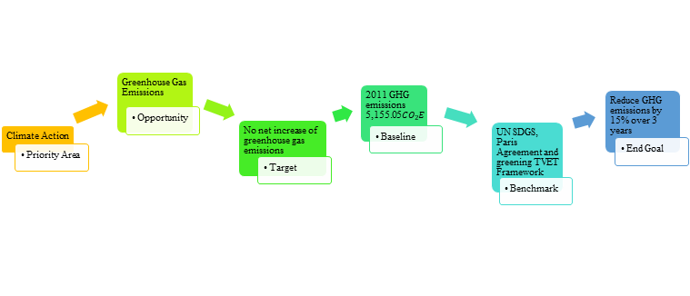
NC Greening TVET Framework Example
Notes:
Moving forward in terms of the role of higher education institutions, the UNESCO has a framework that goes along with advancing in sustainability, which is the greening TVET.
UNESCO defines Greening TVET as Greening Technical and Vocational Education and Training (TVET) different activities for leaders and practitioners of institutions to implement education for sustainable development (ESD).
There are four steps to implement the ESD in a TVET institution which are:
Understanding the process.
Planning for the greening of TVET.
Implementing the institutional greening plan
Monitoring progress and assessing results.
The purpose of TVET is to help in the transition to a low-carbon economy and climate-resilient society by developing new sectors of activity to transform them into environmentally friendly alternatives. It states the need for a more sustainable society. Therefore, the creation of the framework to develop skills and promote the study of technology to avoid different types of environmental impacts.
The following diagram is an example of how the Greening TVET Framework operates and how Niagara College has put this framework in place towards climate action.

Slide 12
SWOT
Strengths
Office of Sustainability.
School of environment own division.
High interest in the environment.
Large number of students in the environmental programs.
Sustainability Fund.
Students offer different perspectives and also have diverse backgrounds.
Geographic location.
Partnerships.
Threats
Lack of jobs.
Political Instability.
Lack of knowledge about local climate change consequences.
Weaknesses
Lack of knowledge of sustainability initiatives.
Student turnover rates.
Limited budget.
Weak transit system.
Small and concentrate field.
Lack of planning and engagement.
O
S
W
T
Opportunities
Participate in environmental groups.
Learning opportunities for students in the environmental field as well as outside of it.
New academic programs like climate change action and energy management.
Advancement on programs
Internships
Improve buildings infrastructure.
Notes:
Along with adopting the greening TVET framework, a swot analysis was also suggested for the following reasons:
The SWOT analysis was created to understand how prepared is Niagara College to put in place the climate change action plan, in terms of what operations are already in place to face climate change and what aspects challenge mitigating or adapting to global warming.
As I mention in the previous slides, Niagara College plays a critical role as high education institution to prepare its students to the challenges of climate change, therefore establishing a baseline was very important.
In terms of the strengths the most important aspects are:
There is an office of sustainability that looks over college operations and promotes their transition to sustainability.
The school of environment used to be part of the school of business, hospitality and tourism, however, this year it was determine that it should be considered as an individual division of Niagara College. Therefore, more advancements towards sustainability could be achieve.
In terms of the weakness the most limiting aspects are:
The lack of knowledge on sustainability initiatives from students and faculty. Students may want to participate on sustainability events or initiatives, but they do not know that they are happening.
Students turnover rates are a big constraint in terms of consistency, students may present great initiatives while they attend the school but when they graduate, their initiative gets forgotten.
In terms of opportunities the most significant are:
The new academic programs that would be establish like climate change action and energy management.
The advancement on programs by including climate change in the curricula.
In terms of threats the most constraining are:
Political instability, since sustainable development also depends on government policies, that are constantly changing.
Lack of knowledge about local climate change consequences.

Slide 13
NC Sustainability Achievement’s Timeline
2017
Audobon International Cooperative Sanctuary at Niagara-on-the-Lake Campus
2011
Installs Geothermal Heat Pump
2011
Forms Sustainability Committee Installs Solar Array
2013
Stars Bronze Rating
2015
Inaugural BioBlitz
2017
Join WWF Living Planet at Niagara-on-the-Lake Campus
2019
Sustainability Plan in place
2009
Strategic Plan Integrates Sustainability
2012
Implements Bottled Water Ban
2014
Inaugural GM Green Program
2016
Stars Silver Rating
2018
Green Automotive Lab Opens
2014
Hot Biodiversity Sumit-Youth Parallel Event
2018
Sustainability Student Initiative Fund
Notes:
Now, after understanding what is Niagara College role in facing climate change, what are its strengths and limitations, it is important to also highlight what have been Niagara College’s sustainability achievements through the years.
In 2016 NC achieved STARS (Sustainability Tracking, Assessment & Rating System) silver rating by AASHE (The Association for the Advancement for Sustainability in Higher Education).

Slide 14
Sustainability Survey Fall 2019
570 students completed the survey across both campuses
93% reported that sustainability is important to them.
89% agreed that science has proven humans are responsible for accelerating changes in climate
71% thought their future work/career will likely be impacted by human accelerated changes in climate
Around 50% of the responders show interest on more sustainability offer in the curriculum, sustainability electives, related projects and research opportunities
Notes:
Another important aspect that encloses Niagara College role is how its students feel about approaching sustainability, therefore a Survey was performed to encourage students to share views on sustainability and the impacts of human accelerated change in climate.
The Sustainability Survey lasted five-minutes, and it was performed on both campuses, in-person using tablets, and in common areas accessed by students outside of class.
The survey consisted of fifteen (15) questions – five (5) demographic items from Planning & Institutional Research (PaIR) and ten (10) core questions developed in consultation with the Office of Sustainability.
Most respondents (87%) were from non-environmental programs for both campuses.
Approximately 77% of respondents were Generation Z (18 to 25 years of age).
So after reviewing the survey results it is clear that the majority of the students have an understanding of the implications of climate change in their future path and are also interested in pursuing a more sustainable approach on their daily lives and would also like to see that in their college.

Slide 15
Benchmarking
Similar institutions have taken even greater strides to reduce their carbon footprint.
01
Similar institutions have received gold stars rating by AASHE for sustainability while Niagara College has only been certified as silver.
02
The purpose of the Climate Change Action Plan was to propose strategies to further advance in sustainability.
03
Notes:
To finalize with the role of Niagara College in Climate Change, benchmarking is a great tool to compare Niagara College’s progress towards mitigating and adapting to climate change with similar institutions.
While the College has taken several steps to reduce their carbon footprint, it was found that similar institutions have taken greater strides to reduce their carbon footprint.
This does not negate the steps taken by the College but does show that there is a need for the College to continue to find ways to become more sustainable to benefit the planet as well as to remain competitive.
Proposed strategies for Niagara College to further mitigate and adapt to climate change are described in the following sections.
I would pass it off to Dmitry to talk about some of this strategies!

Slide 16
Mitigation Strategies for Niagara College
General Strategies:
Develop a Carbon Responsibility program.
Implement new educational opportunities.
Complete a transportation master plan.
Develop a new curriculum.
Implement ISO 50001 and develop an Energy management system.
Introduce the Carbon Taxation/Credit program.
Notes:
As to Mitigation Strategies, Niagara College executives can consider multiple strategies regarding carbon management. These strategies will require the input of multiple departments in order to evaluate feasibility. These mitigation strategies, related to scope 2 and 3 carbon emissions, include the carbon responsibility program development in order to address GHG emissions, implementation of new educational opportunities in order to implement carbon neutrality into college operations and the new curriculum development that will teach the importance of climate change mitigation. In addition, it will be very important to complete a transportation master plan in order to address the scope 3 carbon emissions from commuters.
In addition, one of the carbon management tools that the College can introduce is ISO 50 001. Even though certifying with ISO standards can be expensive, implementation will ensure that facility decisions are made with energy management in mind.
Moreover, the College can consider introducing its own carbon taxation program in order to address carbon use more specifically.

Slide 17
Mitigation
Strategies for Niagara
College
Agricultural-related strategies:
Pollinator Garden construction
Increase the efficience of Nitrogen Fertilizers
Energy-related strategies:
Introduce renewable energy sources
Notes:
One of the great examples of agriculture-related mitigation strategies can be the construction of a Pollinator Garden. Pollinators are critically important for the ecosystem because they allow plants to reproduce, especially nowadays, when many insect species are under threat of extinction. Pollinator Garden will be beneficial not only for the ecosystem but also for the Niagara College Reputation.
Another mitigation recommendation for the college is related to the use of nitrogen fertilizers. Due to the fact that nitrous oxide emissions occur because of nitrogen fertilizers and the fertilizer runoff pollutes the surface and groundwater quality, it is very important to increase the efficiency of nitrogen use as part of the crop cultivation system by better matching the nitrogen supply from fertilizers with nitrogen requirements for crops. Technologies to increase the efficiency of nitrogen use include plant breeding genetic modification, regular soil testing and the use of technologically advanced fertilizers.
Finally, talking about Energy Mitigation Strategies, it will be important to plan for the future and begin to consider the feasibility of introducing renewable energy sources into College infrastructure. It also needs to be stated that Some energy sources such as solar panels are space-intensive and thus placement needs to be considered carefully for each campus to ensure the best use of College property.

Slide 18
Adaptation
Wellness Education
College Operations
Flood Adaptation
Notes:
The three areas where we believe the College can adapt to the effects of climate change are wellness education, college operations and flood adaptation.
Niagara Region is known for having a large number of Ticks in the summer and there is a concern that warmer winters will allows Ticks to persist throughout the year. This is a particular concern for the College because many of the students are either International or not native to Niagara Region and may not be educated on how to prevent Tick bites. Some education is already given for students who do field work as part of their program, but Tick education can be expanded to the general student body because students may want to study outdoors or go hiking in the Region when the weather is warm.
The next area is College Operations. Increased extreme weather events could disrupt normal college operations. Ice or snowstorms could close the school or make it dangerous for staff and students to commute. The College may need to incorporate more flexibility into the Teaching and Learning Plans so that if school is disrupted students do not miss out on course material. The College may also need to consider updating its closure policy so that commuters are not already on their way to school or at school when the decision to close is made. Additional training programs can be developed for staff to educate them on behaviours that reduce carbon footprints and encourage them to pass that information along to students.
The Final area is flood adaptation. As previously mentioned, the both campuses are situated near or on first order streams. There is a possibility that this could increase the risk of flooding at the campuses, however the NPCA has not yet released their new flood plain mapping. This represents an opportunity for the College to implement its own monitoring program to assess how stream levels are affected by storms or heavy precipitation. This lack of data is an example of one of the limitations we experienced throughout the process of writing this report which I’ll go through now.

Slide 19
Limitations
Lack of Region-Specific Data
Limited Internship hours
COVID-19
Notes:
One of the first limitations we encountered was the lack of region specific data in Niagara Region. Climate change has been extensively studied at the global scale. The Canadian federal government has also done a significant amount of research into how Climate Change will affect its sensitive regions such as Northern Ontario. Unfortunately, there is not much research done at the municipal level. This lack of data meant that not many concrete recommendations could be made, because it is not clear how climate change is affecting Niagara Region specifically. Niagara College has an opportunity to partner with other institutions such as Brock University to begin closing this data gap.
Secondly, as part of the internship arrangement we were only working on Wednesdays. This significantly limited the time we had to research the project. While it would have been possible to work on some days outside the internship, the heavy course load of the program left little time outside of the designated Wednesdays to work on the project.
Finally, in March the school closed due to growing concern for the safety of staff and students due to COVID-19. Once the school closed it was not long before internships were also cancelled. The virus also caused personal stress and meant that we had to adjust to finishing classes and projects virtually. The stress combined with the cancelling of the internship limited the amount of time that could be dedicated to the project.
Even with these limitations, we are confident that this report gives the College a sufficient starting place for evaluating their mitigation and adaptation options.

Slide 20
Next steps
Niagara College must assess each recommendation laid out in this plan to evaluate feasibility.
Attempting to achieve a gold star rating to remain competitive and stand out from other institutions.
Keep on advancing and updating the institutional actions towards sustainable development and climate change.
Notes:
After outlining and exposing all the different aspects that Niagara College needs to face climate change it is important to establish what actions are going to be moving forward.
The assessments must include representatives from multiple departments at the College. Once all feasible options are identified, the College can begin to implement and look for more ways to mitigate and adapt to climate change.
As I mention in the benchmarking piece previously many institutions that are similar to Niagara College have achieved gold stars under AASHE.
The certification process would also serve to consolidate the College’s sustainability information into a report that is easy for stakeholders to understand. Additionally, examining the ratings of platinum star holders will help the College develop a vision for what climate mitigation can be achieved in the future. As well as opening the door for future partnerships that could invest in greening projects for Niagara College.

Slide 21
Conclusions
Implications of climate change in the Niagara region and Niagara College
Adopted the greening TVET framework
Work on implementing the mitigation and adaptation actions suggested
Acknowledge that there would be limitations and challenges moving forward
Niagara College is committed to be a role model for its students, faculty, staff, other institutions, the community and even across Canada in addressing climate change
Notes:
Going off the next steps, to finalize we have exposed the preliminary climate change action plan that would be implemented in Niagara College.
It represent a big challenge, but it is the first step that would permit the institution to adapt and mitigate climate change.
First, we went through the implications of climate change in the Niagara Region and Niagara College where we found that there is a lot of gaps in terms of lack of information regarding climate change in a local level.
We also talked about what Niagara College is already doing and how it has adopted the greening TVET framework.
After that we talked about the different mitigation and adaptation strategies that could be put in place, acknowledging that there would be limitations and challenges within this implementation, regardless Niagara College is committed be a role model for its students, faculty, stuff, other institutions, the community and even across Canada in addressing climate change.

Slide 22
Thank you!
We would be happy to answer any questions you have
Notes:
Thank you so much!

Slide 23
References
NC Sustainability. (n.d.). Energy and GHG projects. Retrieved on April 15, 2020 from https://sustainability.niagaracollege.ca/projects/energy/
IPCC, 2018: Summary for Policymakers. In: Global Warming of 1.5°C. An IPCC Special Report on the impacts of global warming of 1.5°C above pre-industrial levels and related global greenhouse gas emission pathways, in the context of strengthening the global response to the threat of climate change, sustainable development, and efforts to eradicate poverty [Masson-Delmotte, V., P. Zhai, H.-O. Pörtner, D. Roberts, J. Skea, P.R. Shukla, A. Pirani, W. Moufouma-Okia, C. Péan, R. Pidcock, S. Connors, J.B.R. Matthews, Y. Chen, X. Zhou, M.I. Gomis, E. Lonnoy, T. Maycock, M. Tignor, and T. Waterfield (eds.)]. World Meteorological Organization, Geneva, Switzerland, 32 pp.
NPCA (n.d.). NPCA Watershed Explorer. Retrieved on February 19, 2020 from https://npca.ca/administration/geographic-information-services
Paterson J.A., Ford, J. D., Ford, L. B., Lesnikowski, A., Berry, P., Henderson, J., and Heymann, J. (2012). Adaptation to climate change in the Ontario public health sector. BMC Public Health, 12:452.
Zhang, X., Flato, G., Kirchmeier-Young, M., Vincent, L., Wan, H., Wang, X., Rong, R., Fyfe, J., Li, G., Kharin, V.V. (2019): Changes in Temperature and Precipitation Across Canada; Chapter 4 in Bush, E. and Lemmen, D.S. (Eds.) Canada’s Changing Climate Report. Government of Canada, Ottawa, Ontario, pp 112-193.
American College & University President's Climate Commitment. (n.d.). Higher Education's Role in Adapting to a Changing Climate . Boston: Second Nature Education for Sustainability .
History & Education. (n.d.). Retrieved from https://www.niagaracollegewine.ca/page?pageid=C89E6567-A592-7316-F1D3-E49B06FD8A6E
Kingston Utilities. (2020). Retrieved on March 11, 2020 from https://utilitieskingston.com/Wastewater/BasementFlooding/Causes
McGill University (2017). Vision 2020. Climate & Sustainability Action Plan 2017 – 2020. Retrieved from
https://mcgill.ca/sustainability/files/sustainability/vision_2020_climate_sustainability_action_plan.pdf
Merloni, E., Camanzi, L., Mulazzani, L., & Malorgio, G. (2018, December 12). Adaptive capacity to climate change in the wine industry: A Bayesian Network approach. Retrieved from https://www.sciencedirect.com/science/article/pii/S2212977418300358#bibliog0005
Penney, J. (2012, April). Adapting to climate change. Retrieved from https://www.niagararegion.ca/government/planning/pdf/climatechangerport.pdf
UNEVOC . (2017). Greening Technical and Vocational Education and Training . Paris : UNESCO.

