Slide 1
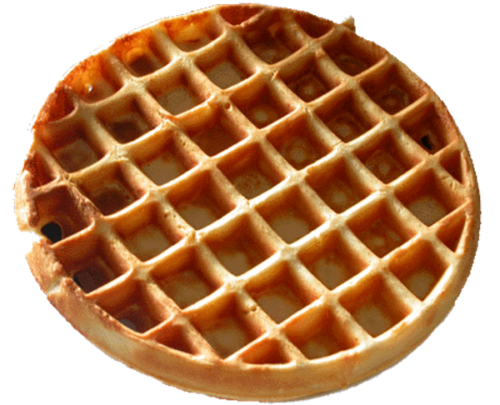

Bee Campus and Wildlife Habitat Council Certifications
P. Moura
2019

Slide 2
Agenda
Personal background
Context of the project
Bee Campus Certification
WHC Certification
Positives
Learnings
Recommendations
Acknowledgements

Slide 3
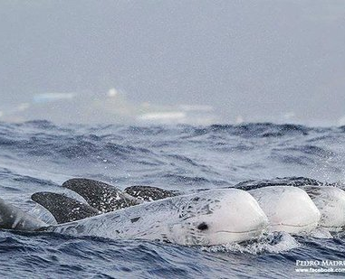
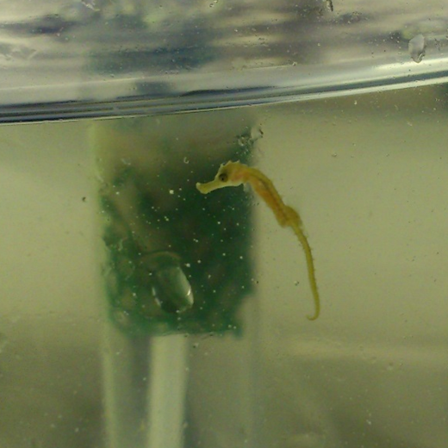
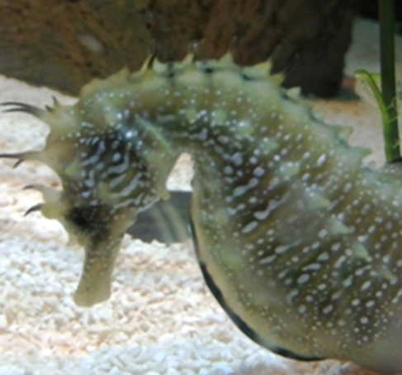
Personal background
Biology, Marine Conservation, Water Resources
Sustainability, Environmental Education and Engagement
“Be the change you want to see in the world.”

Slide 4
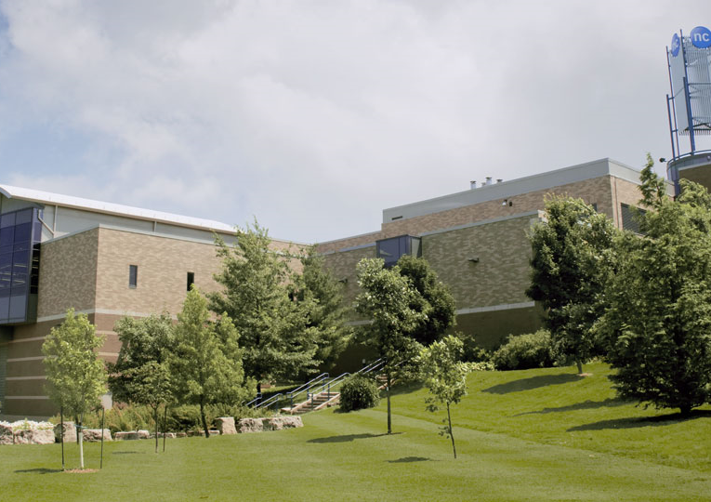
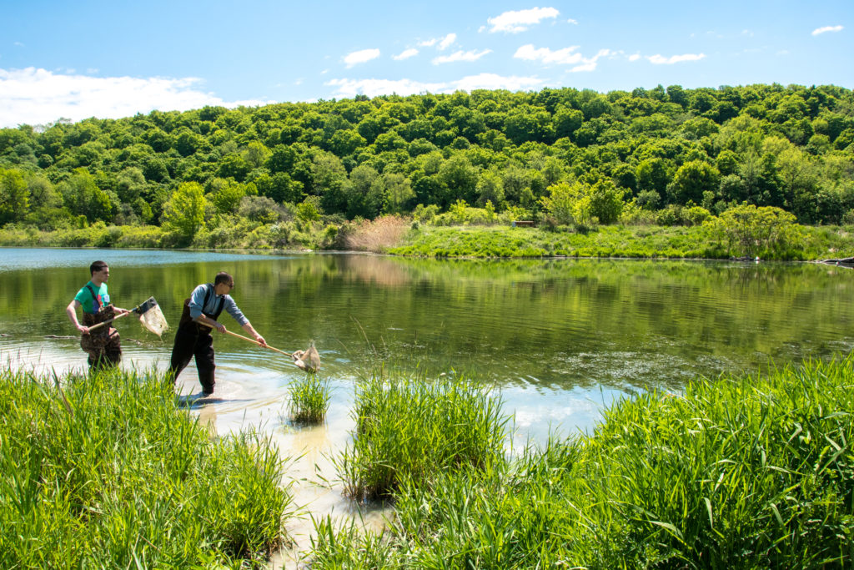
Context of the project
Focus on sustainability
Hands-on approach
Audubon Cooperative Sanctuary Program Certified

Slide 5


Bee Campus Certification
Application – pollinator habitat, education efforts, Pollinator Week celebration
Data gathering – Interviews VS Working Group
Results:
Pollinator habitat
Educational efforts
Pollinator Week celebration

Slide 6

WHC Certification
Application – Program & Projects
Learning process – Webinars and documentation

Slide 7
WHC Certification
Program – Niagara College (NOTL campus)
Habitat - Wetlands
Awareness & Community Engagement – BioBlitz & GM eco STEM
Species – Avian, Reptiles & Amphibians
Habitat - Landscaped
Species – Pollinators
Awareness & Community Engagement – Pollinator Week

Slide 8
Positives
Experience
Networking
Bee Campus!
Future WHC

Slide 9
Learnings
Working groups are effective
Data gathering is very difficult
People are busy
Always keep plans and end goal in mind!

Slide 10
Recommendations
Data centralization makes project continuity better
Working groups!

Slide 11
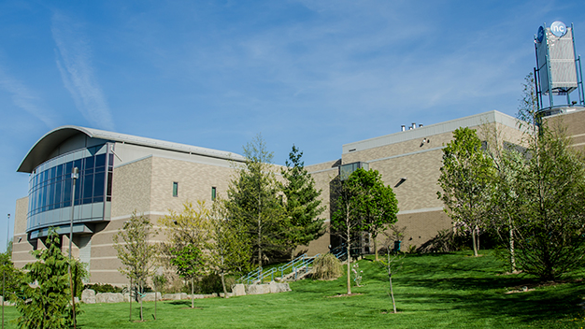
Thank you!
Taryn Wilkinson, Sustainability Advisor
Amber Schmucker, Sustainability Program & Outreach Co-ordinator
Katie Altoft, Environmental Management and Assessment Program Coordinator
Sandy Herkimer, Internship Coordinator
Bee Campus Working Group
  Mylee Nordin, Commercial Beekeeping Program Coordinator
  Kiera Newman, Instructor, Commercial Beekeeping Program
  Kristin Montoya, Faciltites Management Services
  Judy Johnson, Grounds Supervisor
  C. Radimer, Commercial Beekeeping Student
  Mi. Blondeau, Commercial Beekeeping Student
  G. Robinson, Commercial Beekeeping Student
  J. Anderson, Commercial Beekeeping Student

