Slide 1

Future Development and Planning
Of The Niagara-On-The-Lake, Niagara College Campus
S. Millar and M. MacMillan
Notes:
Shannon introduces presentation title and our names. (Brief)

Slide 2
Acknowledgements
Client: Judy Johnson
Thesis Project Adviser: Dr. Xinxia (James) Jiang
Notes:
Shannon
We would like to thank our peers, our adviser Xinxia (James) Jiang, our client Judy Johnson, for attending this presentation today. (Also mention anyone else in attendance, Alan, Dr. David Brown, Caroline McCormick, The Friends of Laura Secord, Gavin, and others who I invited, Shannon, Karen?)
Special thanks to our client Judy Johnson and our adviser Xinxia (James) Jiang for offering guidance to us as we worked to complete this project.
Before we begin we would also like to ask that you please leave any questions until the end of the presentation. Thank you.

Slide 3
Agenda
Project Overview
Study Area
Project Objectives, Goals and Benefits
Methodology
Final Cost and Hours
Earned Value Management
Schedule Timeline
Work Breakdown Structure
Resources Required
Challenges Encountered
Results
Recommendations and Conclusions
Questions
Notes:
Matt

Slide 4
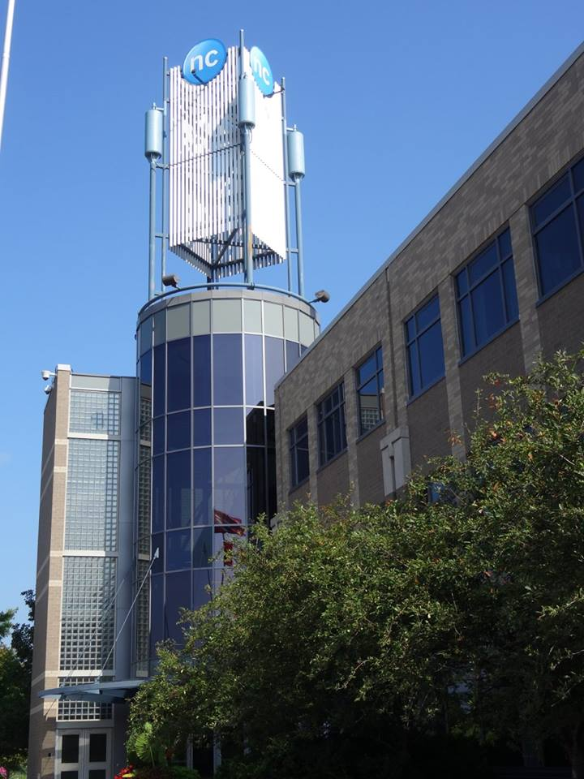
Project Overview
The Niagara-on-the-Lake (NOTL) Niagara College campus has plans for expansion over the next few years
A base map was created as a visual representation of the campus as it is currently and layers were created to showcase features of importance
The Laura Secord Legacy Trail, the Memorial Hill trees, the First Nations, Metis, and Inuit garden, and the raised gardens are important features on campus, that deserve visual documentation
Notes:
Shannon

Slide 5
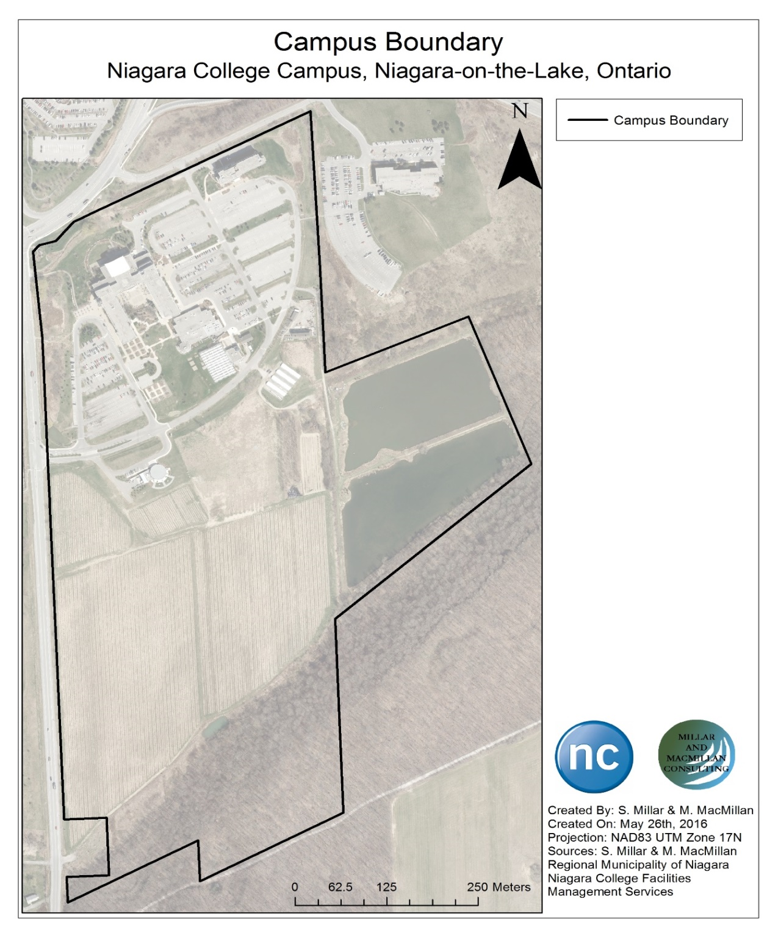
Study Area
The Niagara-on-the-Lake (NOTL), Niagara College campus was established in 1998 and is the study area for this project.
The campus also is located at the base of the Niagara Escarpment which is a UNESCO World Biosphere Reserve.
Notes:
Matt
(NEW:) The study area boundary runs along the bottom edge of the escarpment from the lagoons to the edge of Taylor Road and extends up Taylor road and long the edge of Glendale Avenue beside the residence and down towards the lagoons along the tree line that separates the campus from the next lot, and down around the lagoons to connect back to the escarpment edge.

Slide 6
Project Objectives
Create a base map of the NOTL Niagara College campus.
Collect and process data for the Memorial Hill trees, the raised gardens, First Nations, Metis, and Inuit garden, and hops yard and add these layers to the base map.
Create a proposed route for the Laura Secord Legacy trail through the college campus and add this layer to the base map.
Notes:
Shannon

Slide 7
Project Goal
Create a base map that highlights features of importance to raise awareness regarding their value and significance, and create layers on the base map that can be accessed and modified as changes are implemented on campus.
Notes:
Shannon

Slide 8
Project Benefits
As changes are implemented on campus they can be added to the base map, and compared to previous versions of the map to show a timeline of development.
Spatial information such as location and size of features will allow for the client, Judy Johnson to maintain and manage the college landscape by having a visual layout of the campus.
Notes:
Shannon

Slide 9
Methodology
Data Collection
Review and Identify Data Needs
Verify Provided Data
Initial Geodatabase Creation
Correct Provided Data
Collect Data
Collected Data Processing
Verify Data Quality
Correct Collected Data
Create Map Layers
Ensure All Data is saved to the Geodatabase
Base Map Completion
Notes:
Matt

Slide 10
Cost Disclaimer
This project budget has been prepared for learning purposes and in no way is the client expected to incur these proposed costs.
The value of this project is being donated to the client by the student consultants Shannon Millar and Matt MacMillan, Niagara College and the advisory staff.
Notes:
Shannon

Slide 11
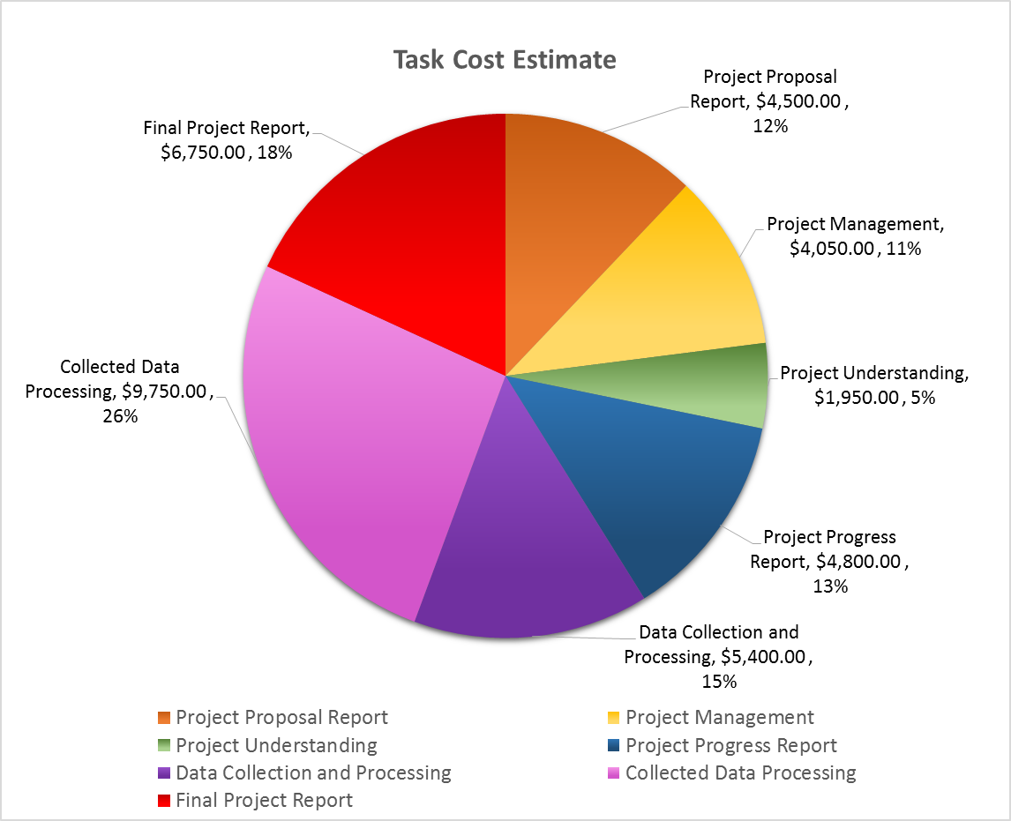
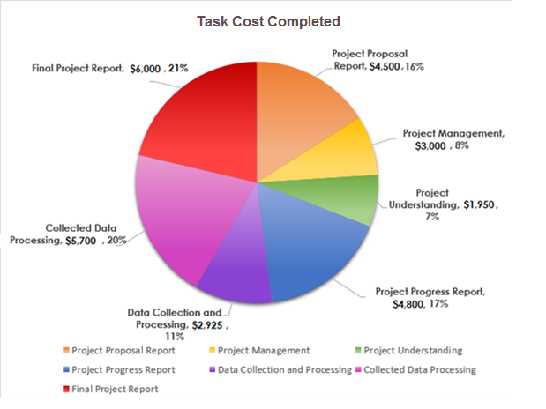
Cost Breakdown By Tasks
Total Cost Estimation
Before Resources,
10% Contingency, and
13% HST Are Added:
$37,200.00
Total Cost Estimation
After Resources,
10% Contingency, and
13% HST Are Added:
$52,900.00
Total Cost of Project:
$28,875.00
Total Cost of Project including Resources, and 13% HST:
$38,425.00
Notes:
Shannon

Slide 12
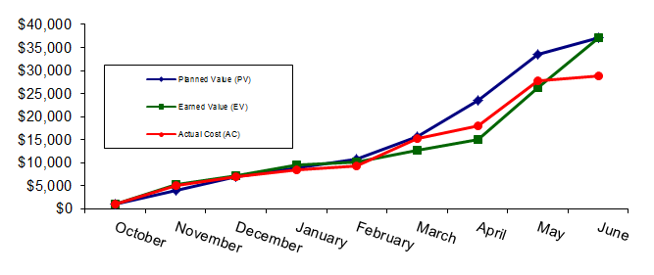
Earned Value Management
Notes:
Shannon

Slide 13
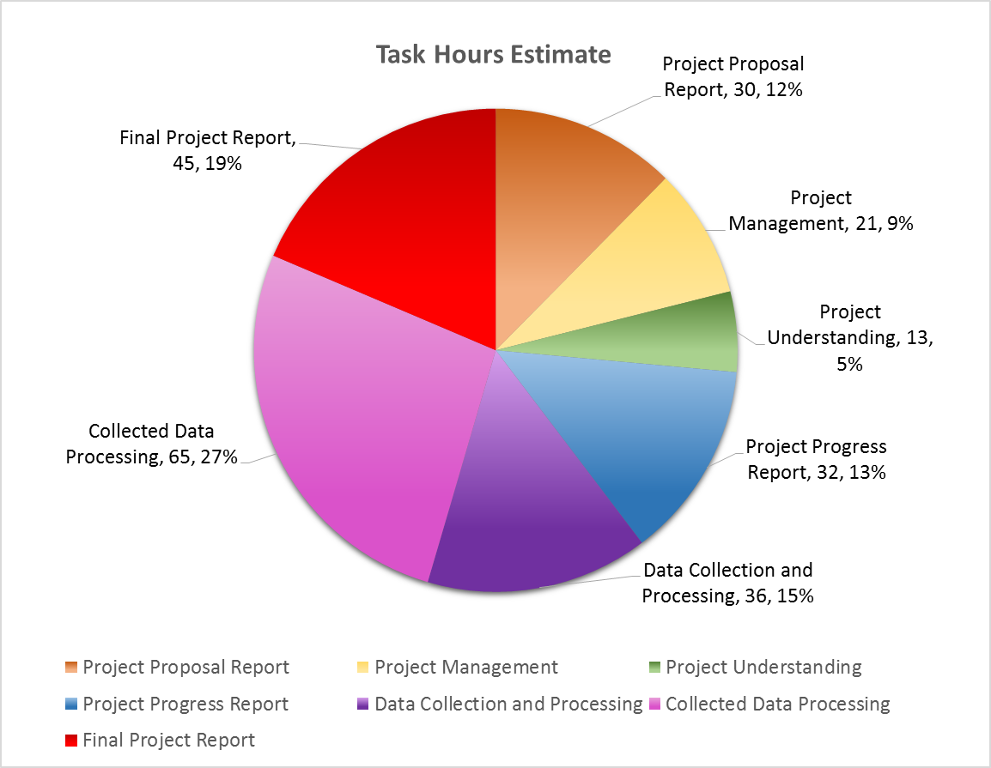
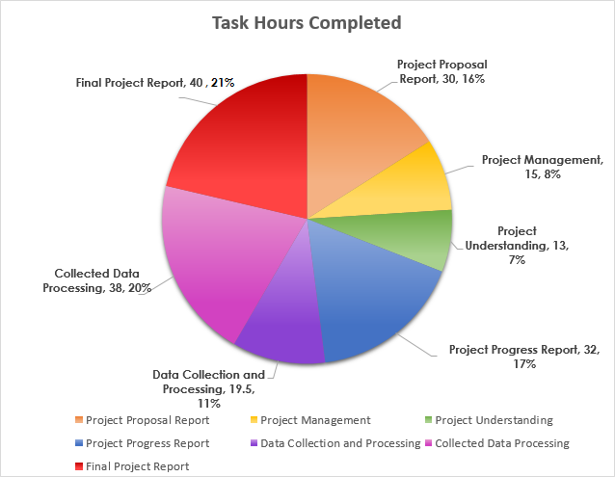
Task Hours Breakdown
Total Hours Estimate:
242
Total Hours Completed
187.5
Notes:
Matt

Slide 14
Schedule Timeline
Schedule Timeline for Completed Project
Task Name | Start Date | Finish Date | Final Work | Final Cost
Future Planning and Development of the Niagara-on-the-Lake Niagara College Campus | 10/8/2015 | 6/10/2016 | 187.5 hours | $28,875
Project Proposal | 11/1/2015 | 12/11/2015 | 30 hours | $4,500
Project Management | 10/8/2015 | 6/1/2016 | 15 hours | $3,000
Project Understanding | 10/15/2015 | 12/11/2015 | 13 hours | $1,950
Project Progress Report | 2/25/2016 | 3/18/2016 | 32 hours | $4,800
Data Collection and Processing | 1/13/2016 | 4/14/2016 | 19.5 hours | $2,925
Collected Data Processing | 3/7/2016 | 5/25/2016 | 38 hours | $5,700
Final Project Report | 4/25/2016 | 6/10/2016 | 40 hours | $6,000
Notes:
Matt

Slide 15
1.0 Future Planning and Development of the NOTL Niagara College Campus
1.1 Project Proposal Report
1.2 Project Management
1.3 Project Understanding
1.4 Project Progress Report
1.5 Data Collection and Processing
1.1.1 Project Proposal Write Up
1.6 Collected Data Processing
1.1.2 Project Proposal Presentation
1.2.1 Client Meetings
1.3.1 Background Research
1.1.3 Submit Project Proposal
1.4.1 Project Progress Report Write Up
1.4.2 Project Progress Presentation
1.5.1 Review and Identify Data Needs
1.6.1 Verify Data Quality
1.6.2 Correct Collected Data
1.6.3 Create Map Layers
1.4.3 Submit Project Progress Report
1.5.2 Verify Provided Data
1.5.3 Initial Geodatabase Creation
1.5.4 Correct Provided Data
1.5.5 Collect Data
1.3.2 Identify Objectives
1.3.3 Define Deliverables
1.3.4 Write Project Overview Statement
1.6.4 Save Data To Geodatabase
1.6.5 Base Map Completion
1.7 Final Project Report
1.7.1 Final Project Report Write Up
1.7.2 Final Project Report Presentation
1.7.3 Submit Final Project Report
1.2.2 Adviser Meetings
Notes:
Matt

Slide 16
Resources Required
Resource Type | Resource Name | Description
Personnel | Shannon Millar | Project Manager
 | Matt MacMillan | GIS Analyst
 | Dr. Xinxia Jiang | Adviser
 | Judy Johnson | Client
Hardware | E308 and Library Computers | Niagara College Property
Software | ArcGIS (ArcMap, ArcCatalog) 10.3 | Provided by Niagara College
 | AutoCAD Map 3D 2015 | Provided by Niagara College
 | Microsoft Office | Provided by Niagara College
Equipment | Trimble GPS Unit | Niagara College Property
 | Safety Vests | Niagara College Property
Project Resources | Resource Cost
Trimble GPS Units | $5000.00
Printing, Paper, Binding | $250.00
USB Professional Copy | $100.00
Total Resource Cost Estimate: | $5350.00
Notes:
Shannon

Slide 17
Challenges Encountered
Not all data were provided and required collection
Weather was not suitable for data collection and planned collection dates were altered
Some incomplete data(Tree Inventory)
Notes:
Matt

Slide 18
Results
Notes:
Matt

Slide 19
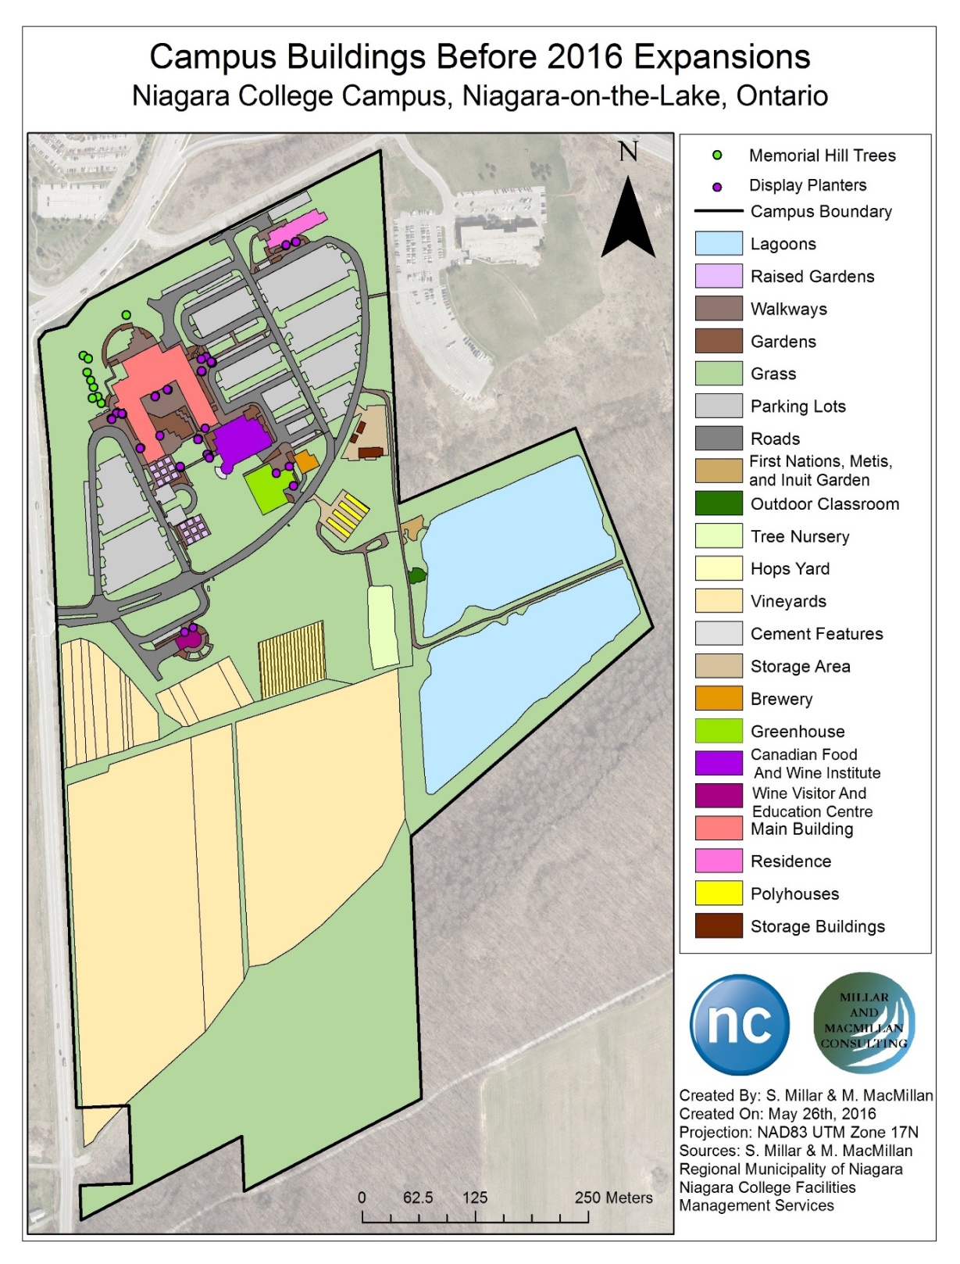
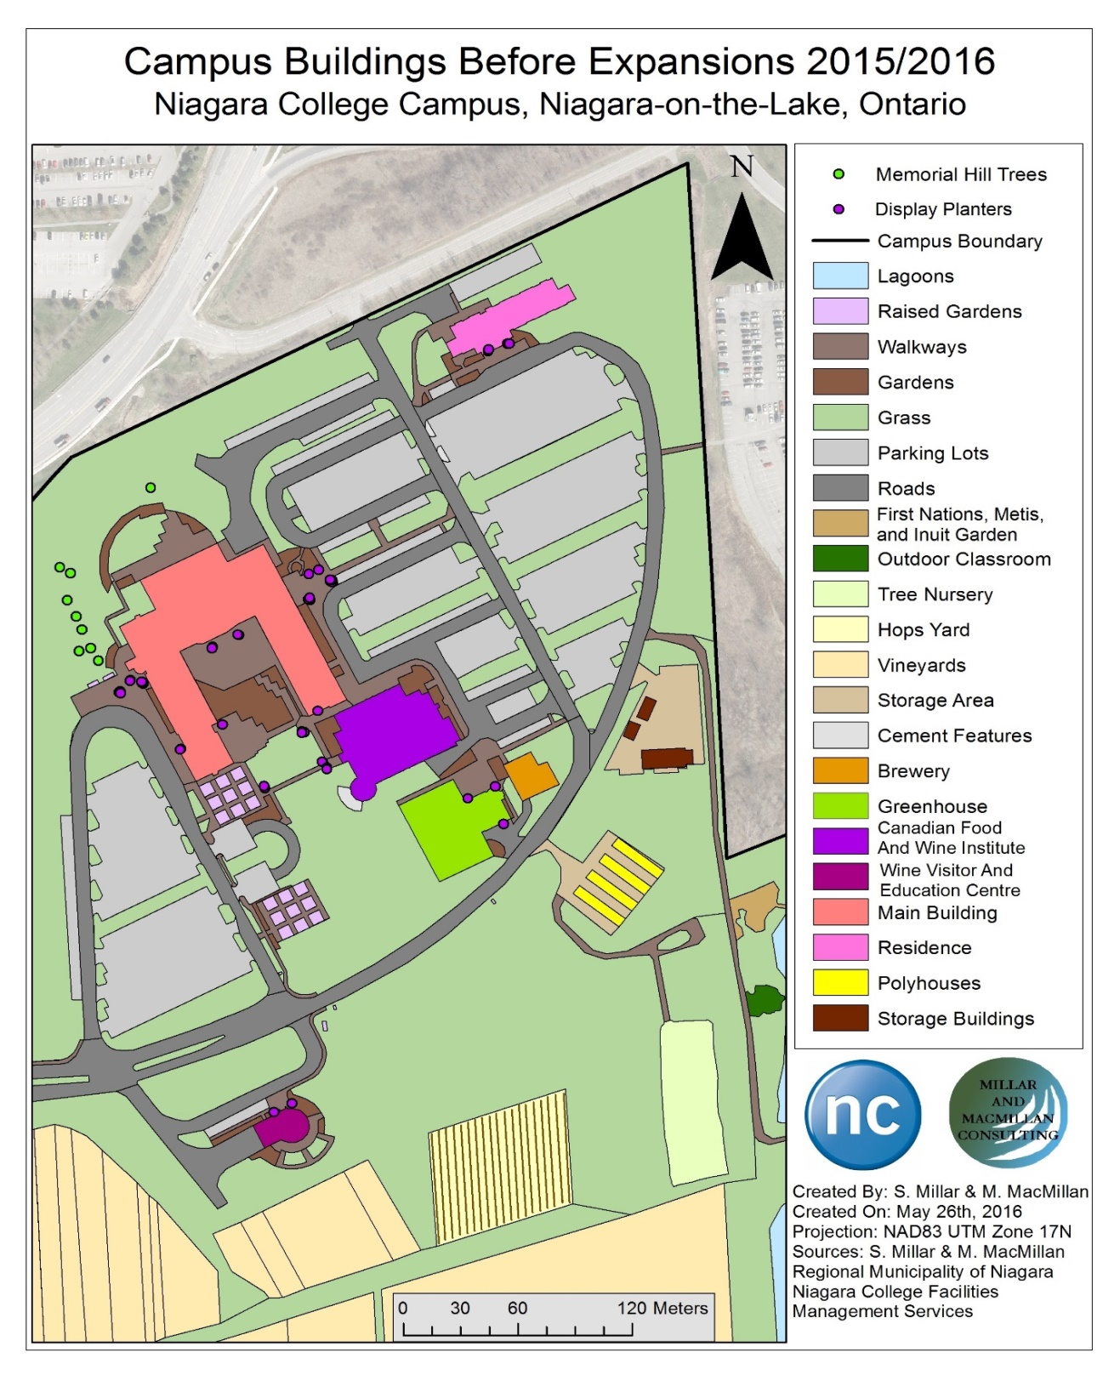
Notes:
Shannon

Slide 20
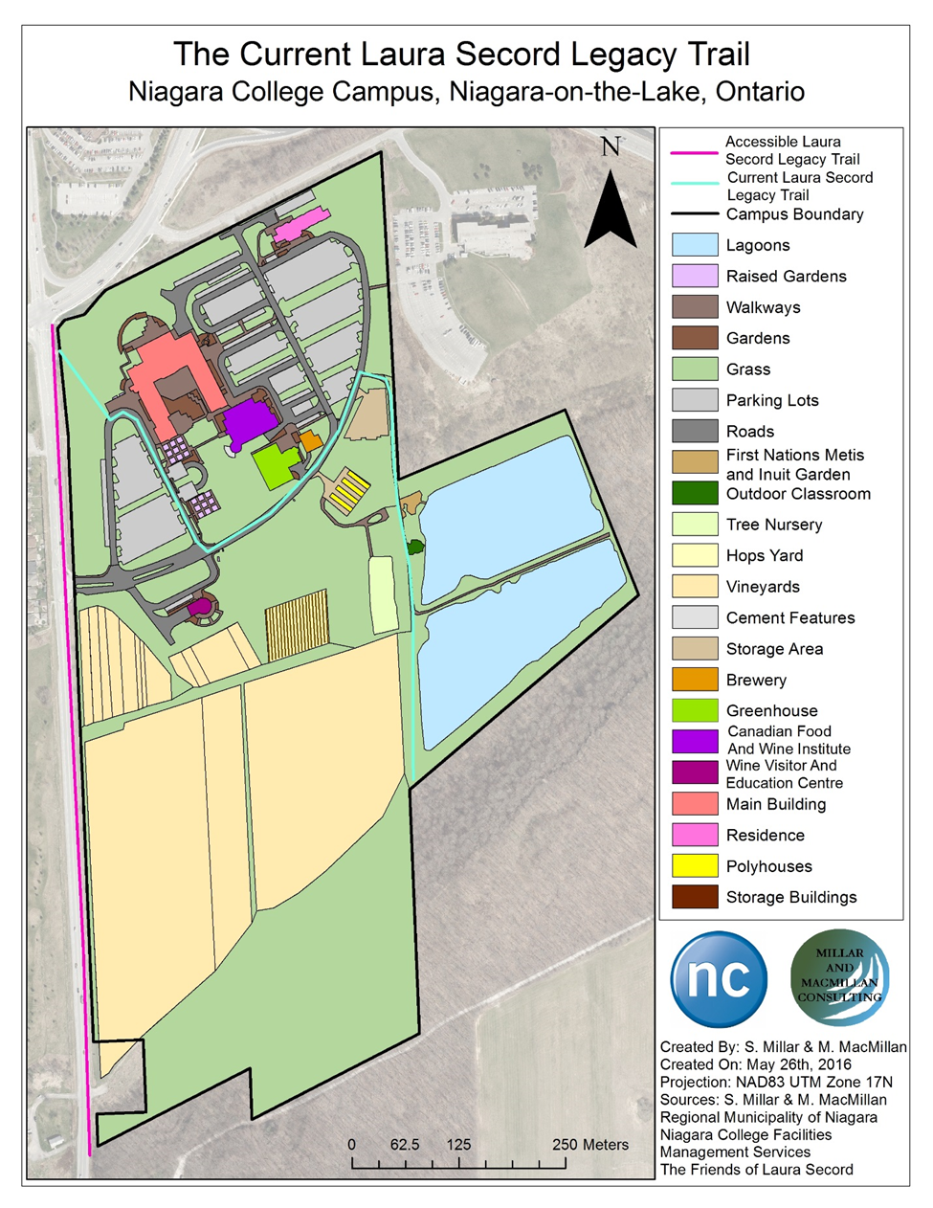
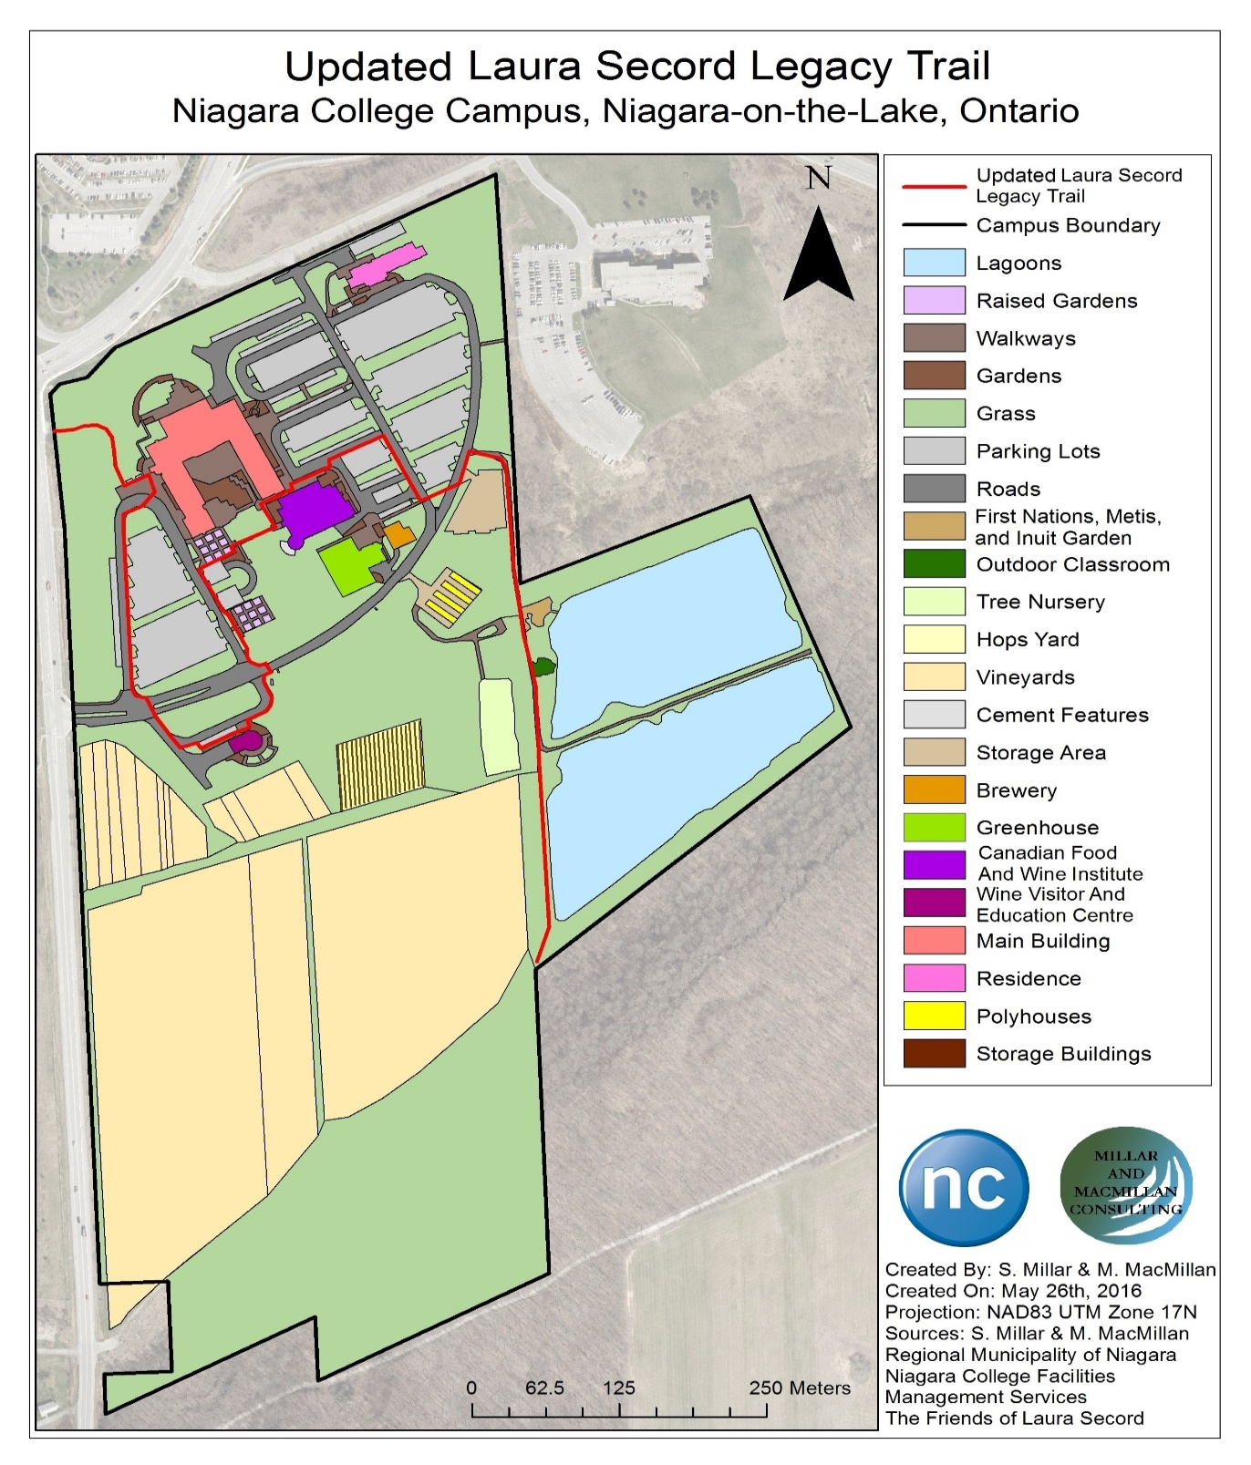
Notes:
Shannon

Slide 21
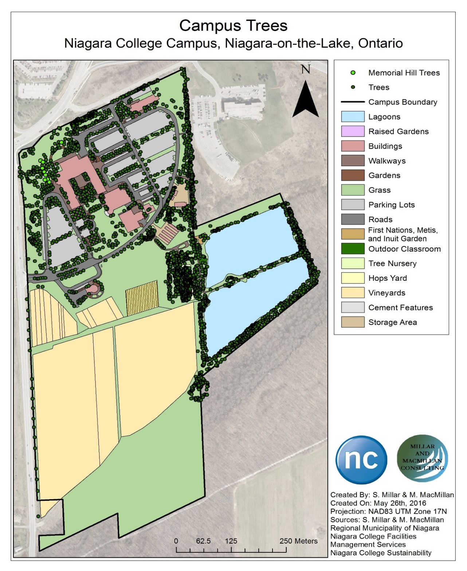
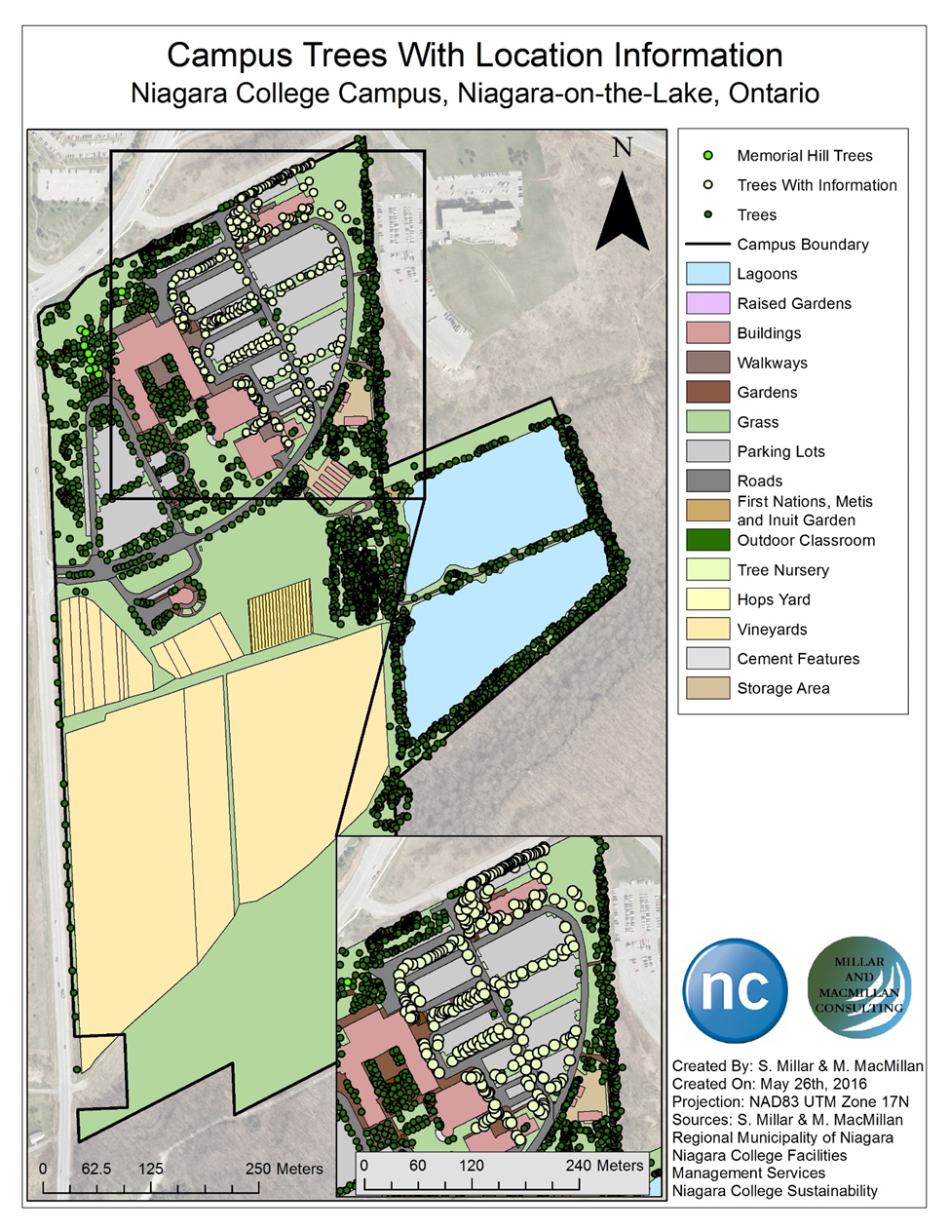
Notes:
Matt

Slide 22
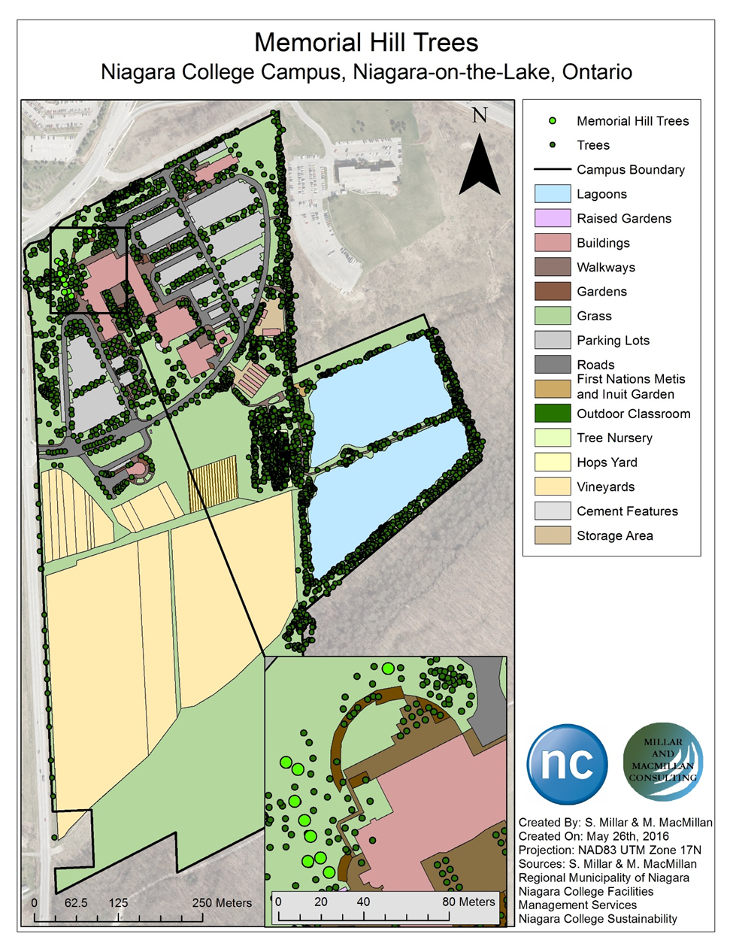
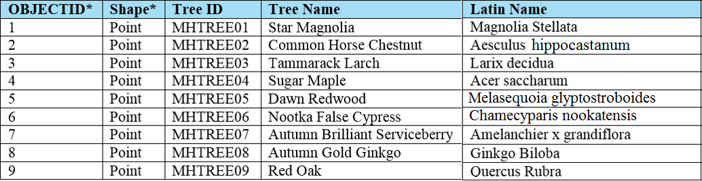
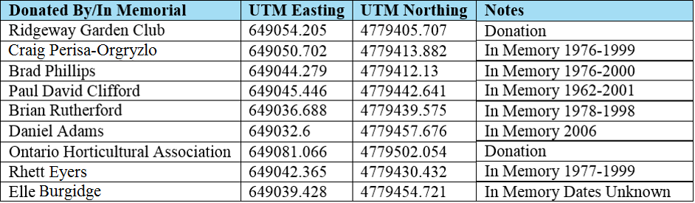
Memorial Hill Trees Attribute Table Part 1
Memorial Hill Trees Attribute Table Part 2
Notes:
Matt

Slide 23
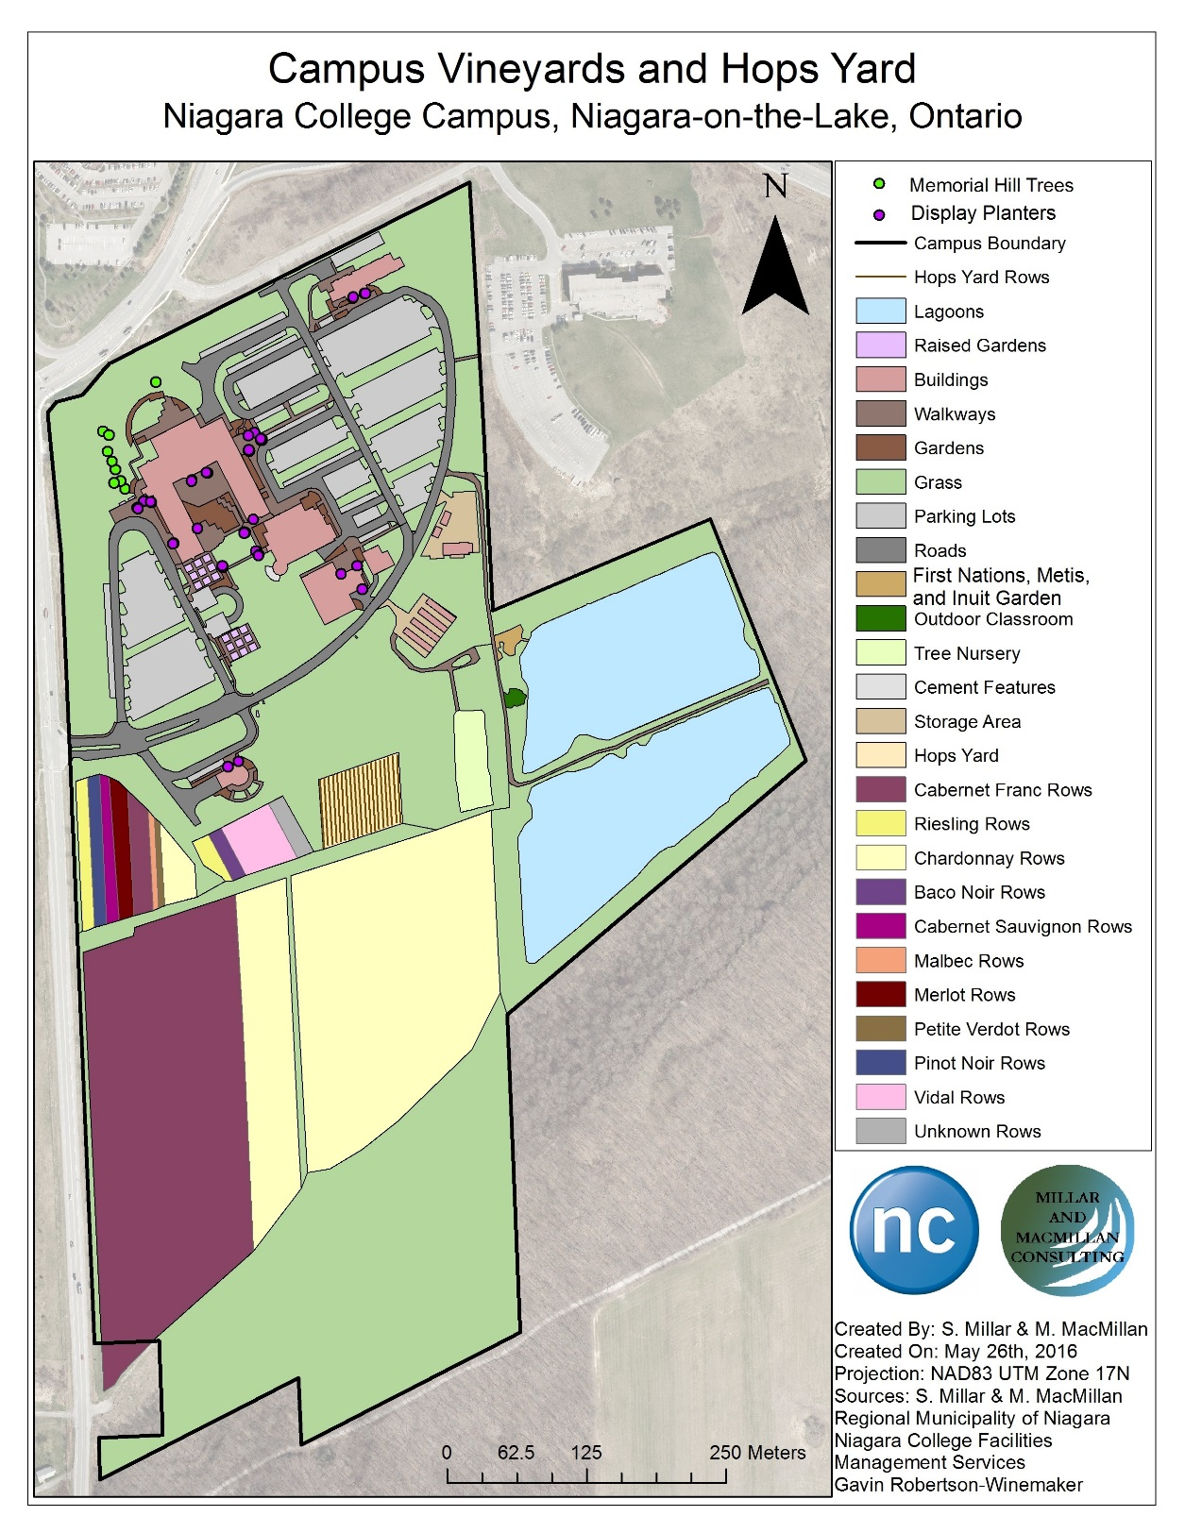
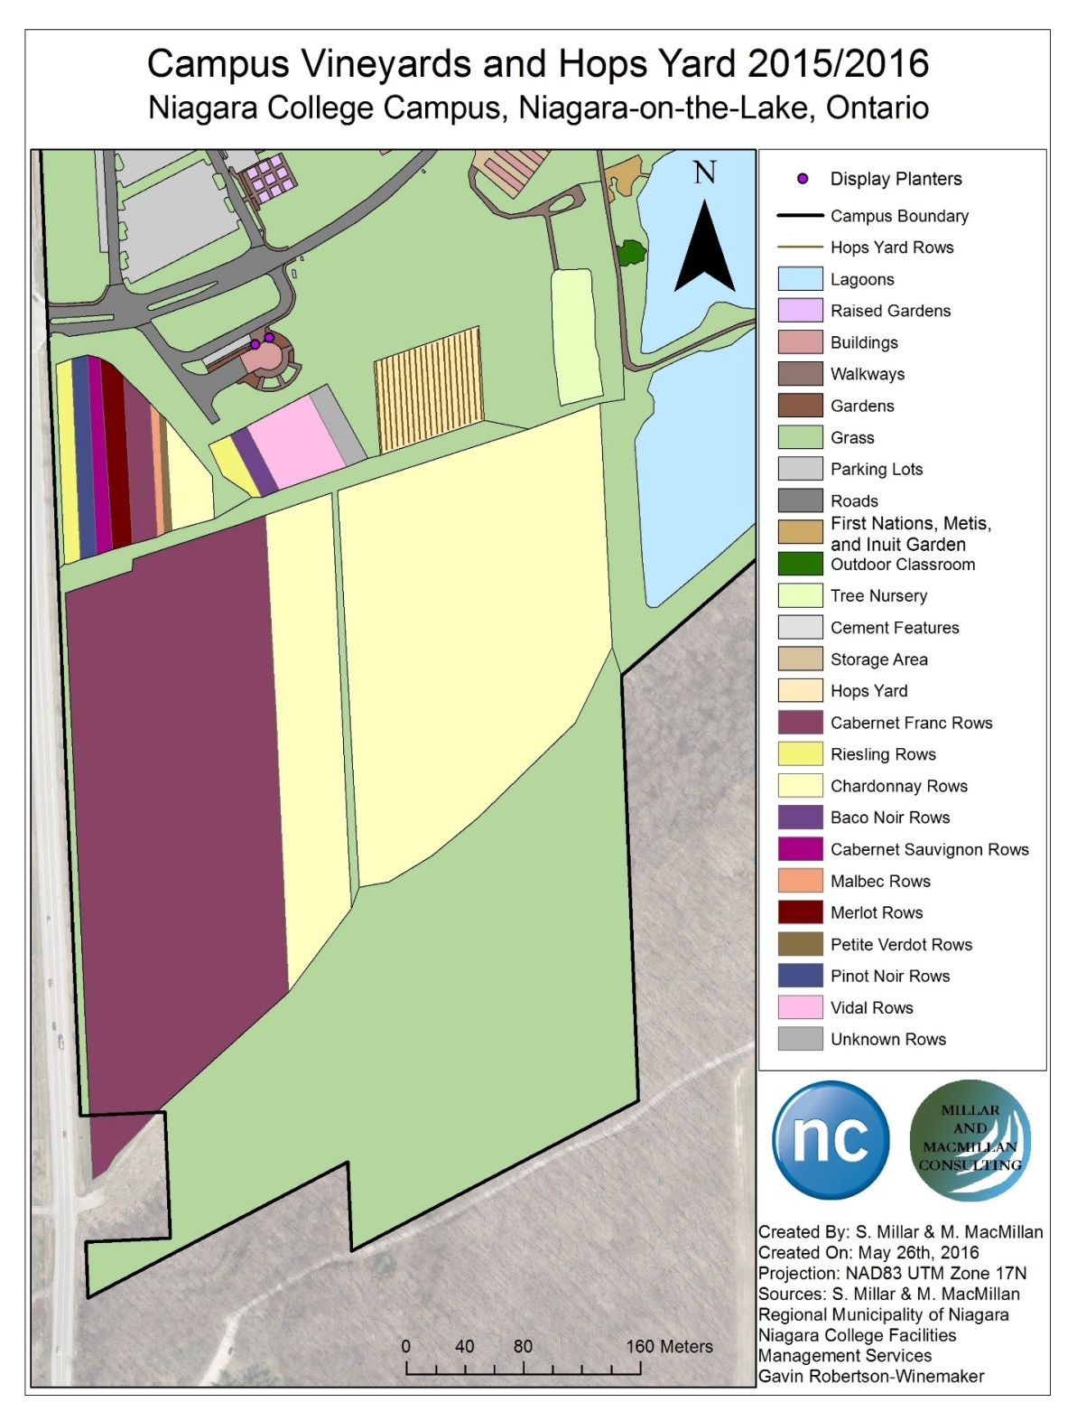
Notes:
Shannon

Slide 24
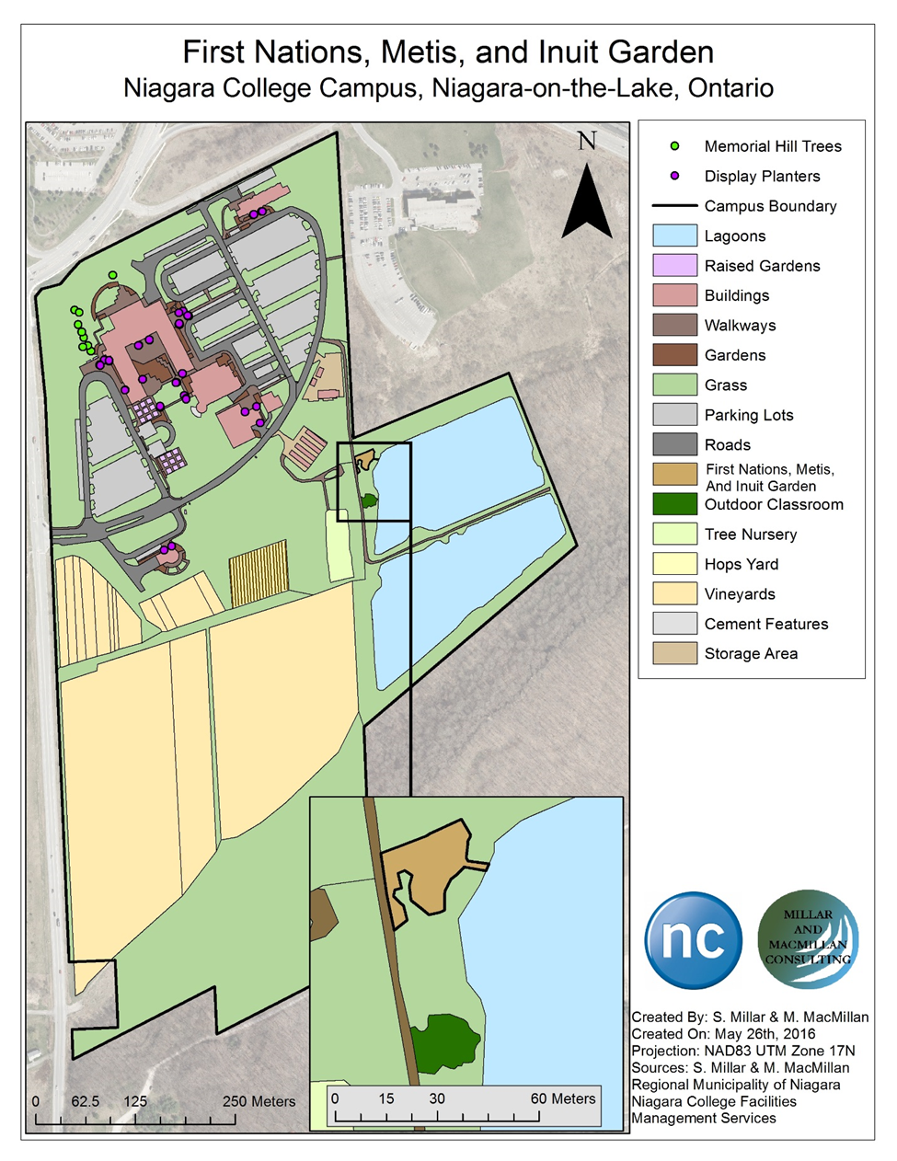
First Nations, Metis, and
Inuit Garden
The First Nations, Metis, and Inuit Garden is an important feature on campus.
The garden is a learning environment for students and is a horticultural initiative with plants from the garden used for traditional food, medicine and ceremonies.
Notes:
Shannon

Slide 25
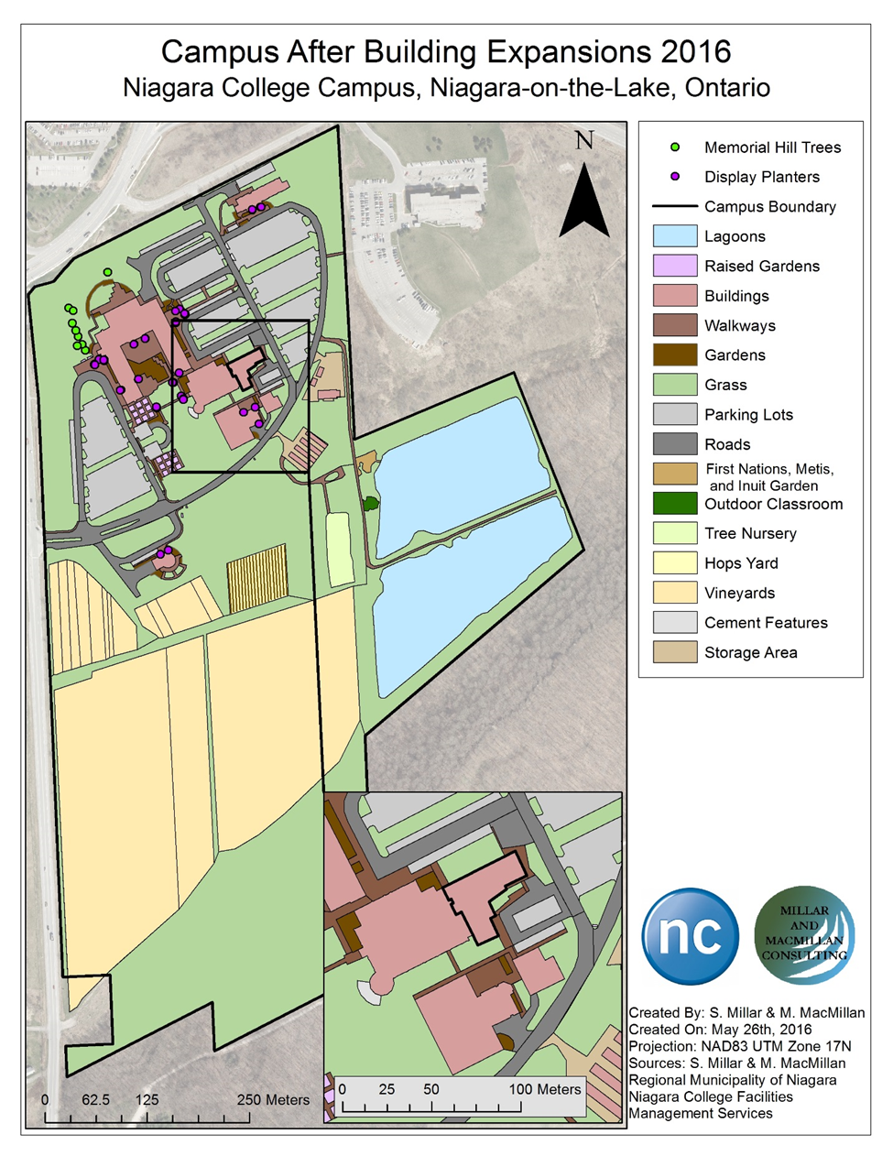
Campus After 2016
Building Expansions
Expansion has already begun on the Canadian Food and Wine Institute on campus with an addition to the existing building and changes to the parking lot and landscape surrounding it. This is one of the first expansions to occur as many others will begin within only a few months.
Notes:
Matt
The new expansion is still under construction and therefore incomplete, however, the building plans have been made available in a PDF document to the project team by the client Judy Johnson. After viewing these plans and the building measurements, the new addition was able to be added onto the Canadian Food and Wine Institute and highlighted on a map.

Slide 26
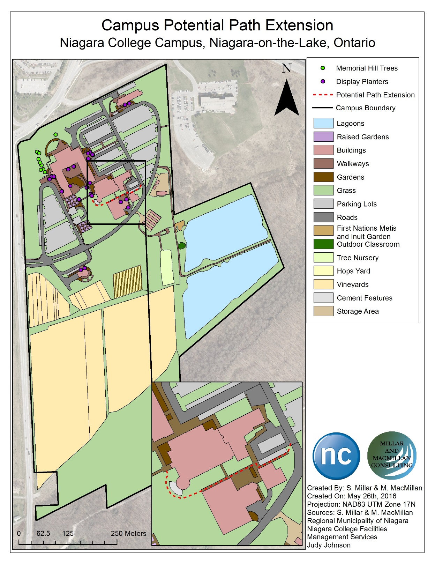
Potential Path Extension
Links the Teaching Brewery and greenhouse to the front of the Canadian Food and Wine Institute where the Benchmark Restaurant is located.
This pathway would allow for quick accessibility between the three buildings.
Notes:
Matt

Slide 27
Recommendations and Conclusions
More layers can be added to the base map as the campus continues
to change
A 3D model of the campus can be completed by determining
the heights of the buildings
As the campus changes past layers can be viewed which will allow
for a timeline of development to be seen
This base map will be a beneficial tool for further strategic planning
of the Niagara-on-the-Lake (NOTL), Niagara College campus should
other layers continue to be added as development of the campus
occurs
Notes:
Shannon

Slide 28
Acknowledgements
Dr. Xinxia (James) Jiang- Adviser
Judy Johnson- Client
Taryn Wilkinson and Gina Pannunzio- Sustainability
2015 and 2016 Sustainability Co-Op
Bartholomew Lanni- Facilities Management Services
Gavin Robertson- Niagara College Winemaker
Caroline McCormick- Friends of Laura Secord
Dr. David Brown- Brock University
Alan Unwin- Associate Dean of the Niagara College School of Environmental and Horticultural Studies department.
Notes:
Shannon
Once again we would like to thank our client Judy Johnson and our adviser Xinxia (James) Jiang for offering guidance to us as we work to complete this project.
Due to the nature of this project, there are several people who have been in contact with the project team and Judy Johnson to contribute valuable input and their expertise to ensure the project is completed successfully. Due to their contributions to the project we would like to thank the following people: Bartholomew Lanni for supplying the AutoCAD drawing which helped us finish digitizing the campus much more quickly. Gavin Robertson for supplying information on the vineyards such as the number of rows, sections, and wine types. Taryn Wilkinson and Gina Pannunzio of Sustainability, along with their new co-op students and original co-op students Courtney Nadon and Maddie Gouett, who have supplied information and data for the previous tree inventory and share an interest in the inclusion of the natural features on the base map. We would also like to thank Dr. David Brown of Brock University, Caroline McCormick of the Friends of Laura Secord and Alan Unwin the Associate Dean of the Niagara College School of Environmental and Horticultural Studies department as they have shared their input regarding the placement of the Laura Secord Legacy Trail. Approval for the official designation of the proposed trail route was given by them as well as Judy Johnson.

Slide 29
Bibliography
2016. Bruce Trail Conservancy. Accessed May 13, 2016. http://brucetrail.org/.
ESRI. 2012. GIS in Education: Accross Campuses, Inside Facilities. ESRI Press.
Johnson, Judy. 2015. "Biography.“
Leavey, Peggy D. 2012. Laura Secord Heroine of the War of 1812. Toronto, Ontario: Dundurn Press.
MacMillan, Matt. 2015. "Study Area of the Niagara-on-the-Lake Campus.“
McKenzie, Ruth. 1972. Laura Secord: The Legend and the Lady. Toronto, Ontario: McCleland and Stewart Limited.
Millar, Shannon. 2015. "Niagara College.“
Niagara College Canada. 2015. "About Niagara College." Niagara College. Accessed December 1, 2015. http://www.niagaracollege.ca/about-niagara-college/.
—. 2015. "Niagara-on-the-Lake Campus." Niagara College. Accessed December 1, 2015. http://www.niagaracollege.ca/about-niagara-college/campuses/notl-campus.
—. 2015. "Our History." Facilities Management Services Niagara College. Accessed December 1, 2015. http://fms.niagaracollege.ca/content/Home/OurHistory.aspx.
Richardson, Karen. 2012. "A 3D GIS Solution for Campus Master Planning." In GIS in Education: Accross Campuses, Inside Facilities, by ESRI, 10-12. ESRI Press.
Richardson, Karen. 2012. "Building a University of the Future." In GIS in Education: Accross Campuses, Inside Facilities, by ESRI, 13-18. ESRI Press.
Steglinski, Lori, and Leah Bercovitch. 2013. "The Establishment of the Laura Secord Legacy Trail In The Niagara Region, Ontario." Thesis, School of Environmental and Horticultural Studies, Niagara College Canada, Niagara-on-the-Lake, 1-57.
The Friends of Fort George. 2013. "The History of Fort George." The Friends of Fort George. Accessed November 24, 2015. http://www.friendsoffortgeorge.ca/fort-george/history/index.html.
Witcher, Ericka. 2012. "A Garden's-Eye View." Chap. 2 in GIS in Education: Accross Campuses, Inside Facilities, by ESRI, 23-25. ESRI Press.
Notes:
Shannon

Slide 30
Questions
Notes:
Shannon

